Slide 2

Intelligent Health Record Aggregation Platform
Your Online Solution to Patient Record Requests, Retrieval, and Intelligent Organization

Slide 3
Intelligent Health Record Aggregation Platform
Your Online Solution to Patient Record Requests, Retrieval, and Intelligent Organization
Referral Management Solution (RMS)

Slide 5
First time viewers click here to begin
(Click here to resume a previous session)

Slide 6
Click the STOP Sign to exit the program:
(or go back to review a previous module)
INTRODUCTION
PATIENT DEMOGRAPHICS
PATIENT INTAKE OPTIONS
IDENTIFYING RECORDS PROVIDERS
MANAGE PATIENT TO-DO LIST

Slide 8
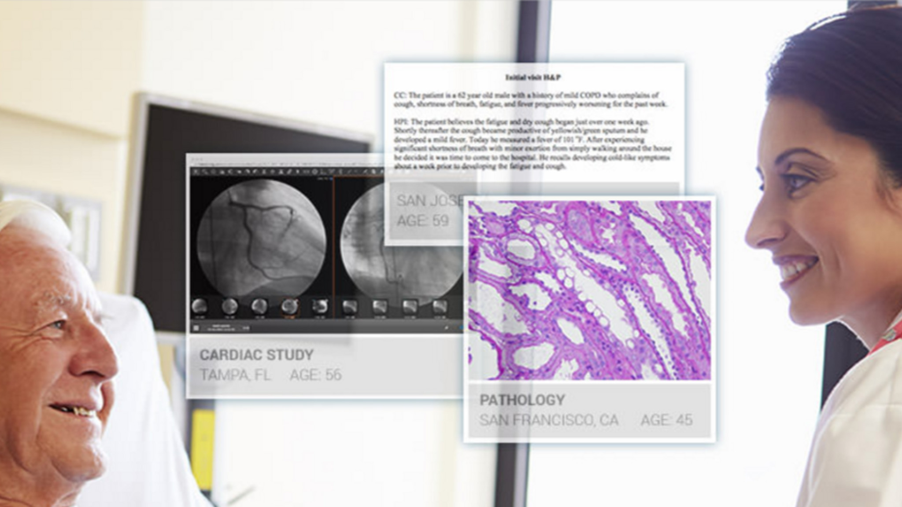
The Referral Management Solution Internet portal allows you to take control of your intake process, and quickly access outside records with an easy to use, all in one patient-centric system

Slide 9

The purpose of this program is to familiarize you with the essential functions of the RMS portal

Slide 10

We understand you may have questions that will not be addressed in the program and encourage you to take notes

Slide 11

Contact information for our Technical Support Staff will be provided at the end of the final module

Slide 12
They are ready and able to answer any questions you may have on the Solution

Slide 13
So, let’s begin with an overview of the RMS functional process

Slide 14
Referral Management Solution (RMS)
There are three basic tasks that must be completed before an RMS Records Request can be initiated:
1
2
3

Slide 15
Referral Management Solution (RMS)
1
2
3

Slide 16
Referral Management Solution (RMS)
Enter Patient Demographics
2
3
Name
Social Security Number
Address
Contact Info

Slide 17
Referral Management Solution (RMS)
Enter Patient Demographics
Patient Intake Options
3
Name
Social Security Number
Address
Contact Info
Department
Referral Reason
Referring Physician
Requested Physician
Diagnosis
Insurance Provider

Slide 18
Referral Management Solution (RMS)
Enter Patient Demographics
Patient Intake Options
Identify Records Providers
Name
Social Security Number
Address
Contact Info
Department
Referral Reason
Referring Physician
Requested Physician
Diagnosis
Insurance Provider
Identify Record Retrieval Providers

Slide 19
Referral Management Solution (RMS)
Enter Patient Demographics
Patient Intake Options
Identify Records Providers

Slide 20
Referral Management Solution (RMS)
Enter Patient Demographics
Patient Intake Options
Identify Records Providers
Once these three task areas are complete, you will then submit the Records Request
Submit Records Request

Slide 21
Referral Management Solution (RMS)
Enter Patient Demographics
Patient Intake Options
Identify Records Providers
Managing the Patient To-Do List will show how to retrieve and work with report information provided by eHealth Technologies
Submit Records Request
Manage Patient To-Do List

Slide 22
Referral Management Solution (RMS)
Enter Patient Demographics
Patient Intake Options
Identify Records Providers
Manage Patient To-Do List

Slide 23
Now go on to the next program module:
(or go back to review a previous module)
INTRODUCTION
PATIENT DEMOGRAPHICS
PATIENT INTAKE OPTIONS
IDENTIFYING RECORDS PROVIDERS
MANAGE PATIENT TO-DO LIST

Slide 24
Referral Management Solution (RMS)
Enter Patient Demographics
Patient Intake Options
Identify Records Providers
Manage Patient To-Do List

Slide 26

Every new records request will begin at the portal login page

Slide 27
From your browser, go to https://rms.ehgt.com

Slide 28
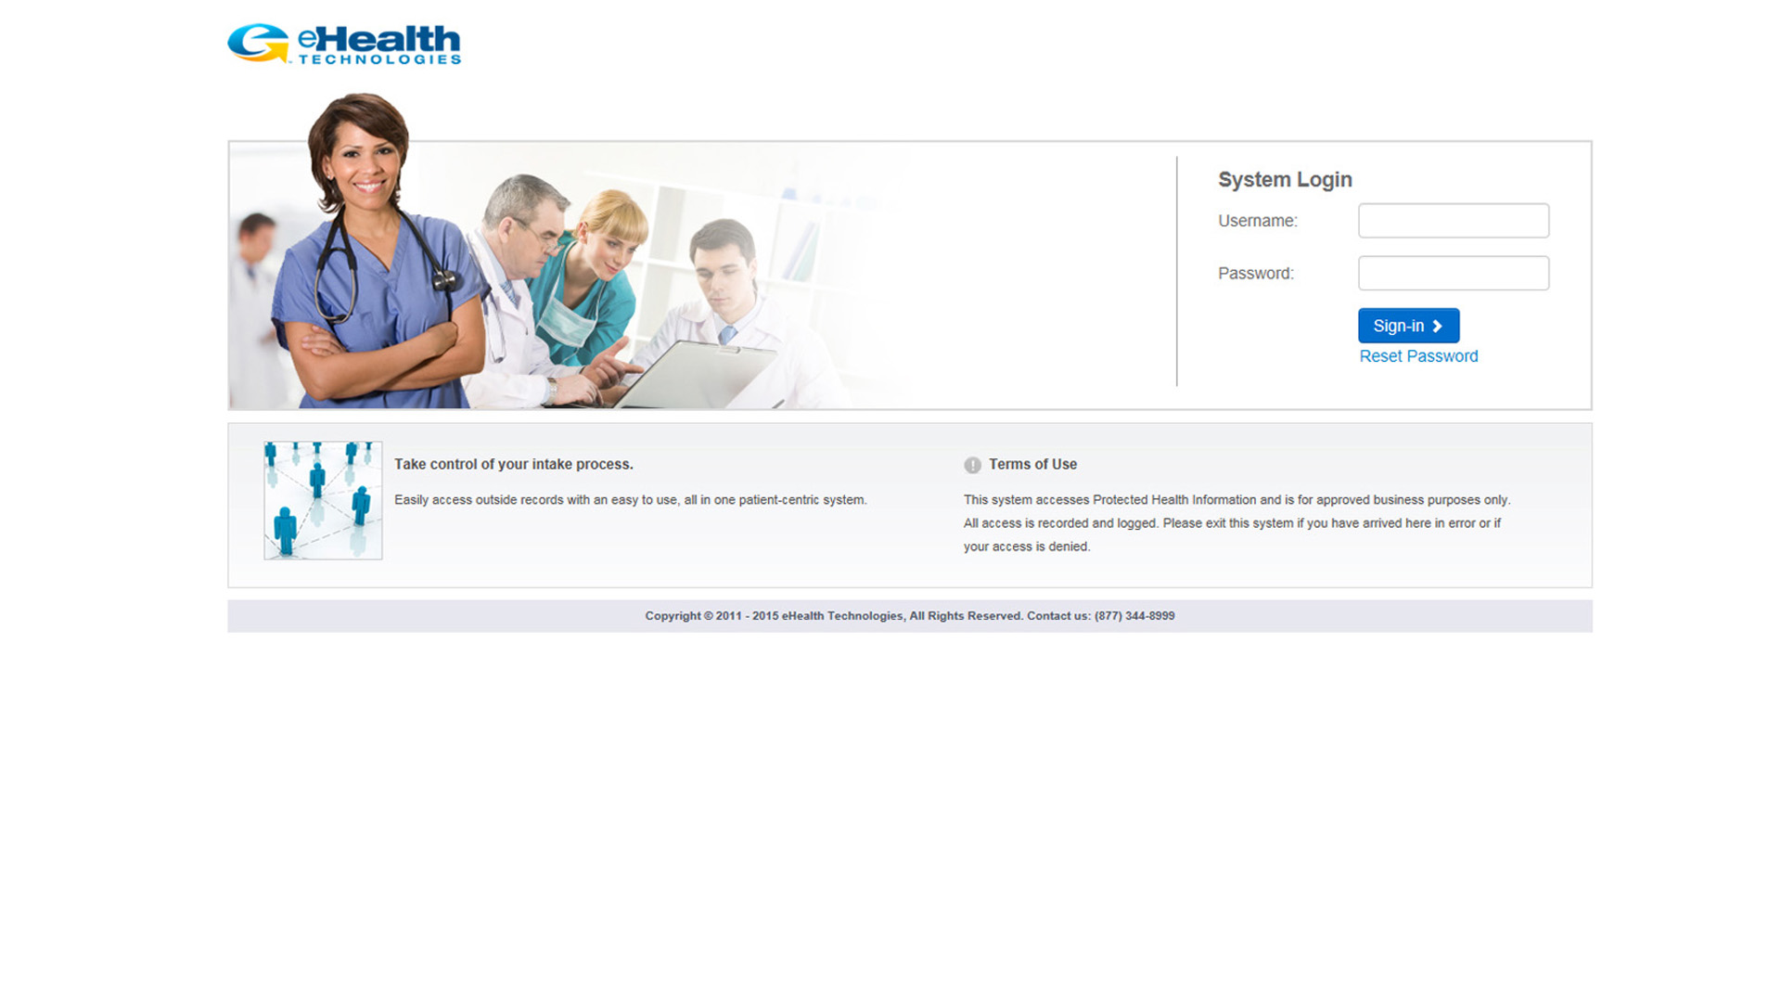
Enter your assigned login (not your email address) and password, and click Sign In to enter the portal and access RMS
NOTE: a password can be reset by clicking on Reset Password. You will provide an email address and an email will be generated and sent. Follow the email directions to complete the password reset procedure for your RMS account. If unsuccessful, please call 877-344-8999, IT Support, Option #5

Slide 29
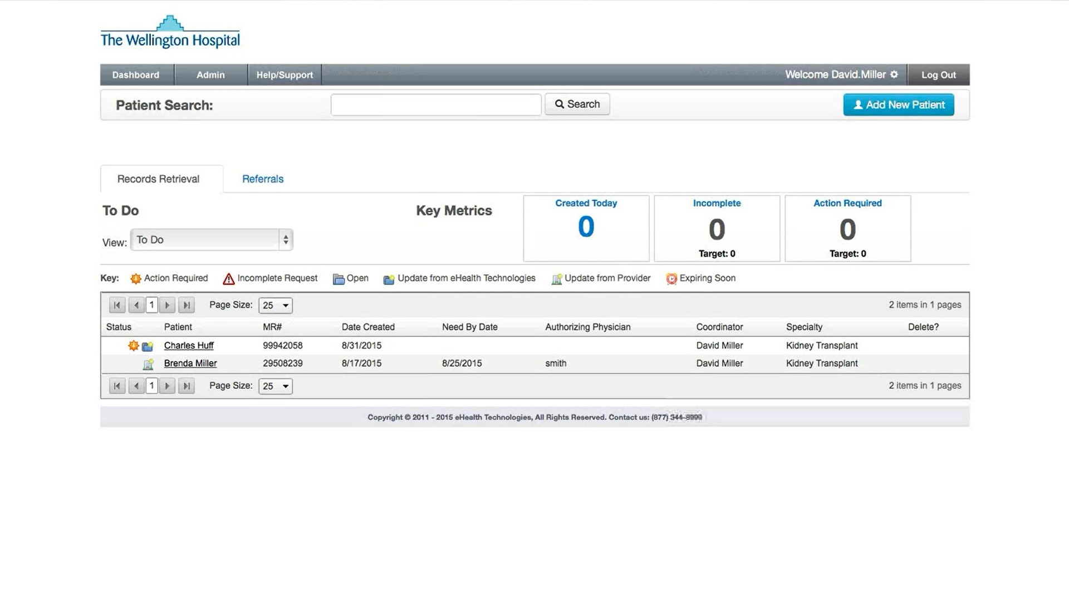
Once logged in, the first area you will see is the To Do screen. This is the main RMS dashboard. It is the default page for every login

Slide 30
We would like to mention two very important things about using the RMS portal. The first item is about navigating within the portal

Slide 31
When available, always use the Back button to return to a previous screen
NOTE: do not use the back arrow on your browser as this may end the session unexpectedly

Slide 32
If the Back button is not available, click on the Dashboard button in the Navigation Bar to return to the Main Dashboard page

Slide 33
The grey Navigation Bar along the top of the page will be present on all RMS screens

Slide 34
The grey Navigation Bar along the top of the page will be present on all RMS screens
NOTE: the Admin button has no current functionality

Slide 35
The other item is about security. The portal will timeout after 2 hours of inactivity and automatically locks as a security measure

Slide 36
Once a session times out, you will need to log back in to regain access to the RMS portal and continue working

Slide 37
Clicking the Help/Support button will display links to download

Slide 38
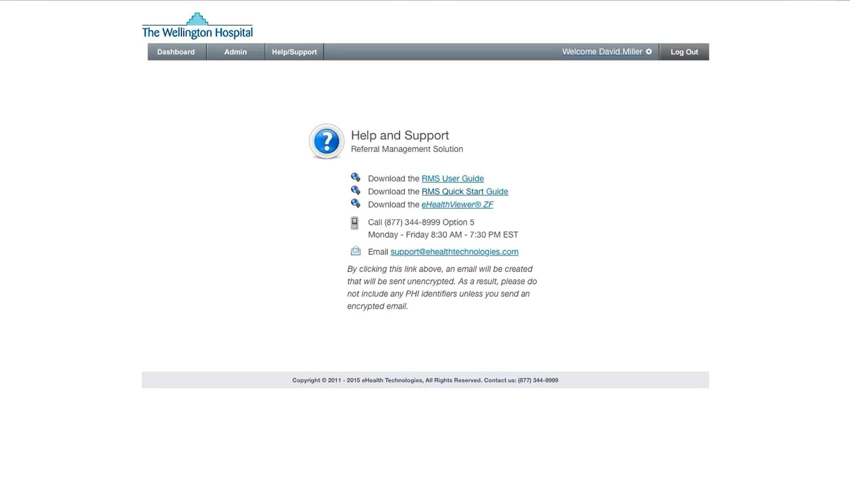
Full RMS User Guide
RMS Quick Start Guide
eHealthViewer ZF User Guide
RMS Support Telephone Number
RMS Support eMail Address
NOTE: email sent to the support email address is unencrypted. This address is not suitable for communicating any confidential PHI identifiers

Slide 39
Click the Dashboard button to return to the main Dashboard page

Slide 40
These Key Metrics areas are clickable widgets that redirect you to a set of matching criteria
NOTE: the output data is department specific

Slide 41
The Patient List shows the patient’s record request in process once eHealth Technologies has begun to send back related records or messages

Slide 42
The information is sortable via individual table headings

Slide 43
For example, to sort the patient records by their creation date, simply click on the Date Created heading

Slide 44
You can also filter the information by choosing from the different view options of:

Slide 45
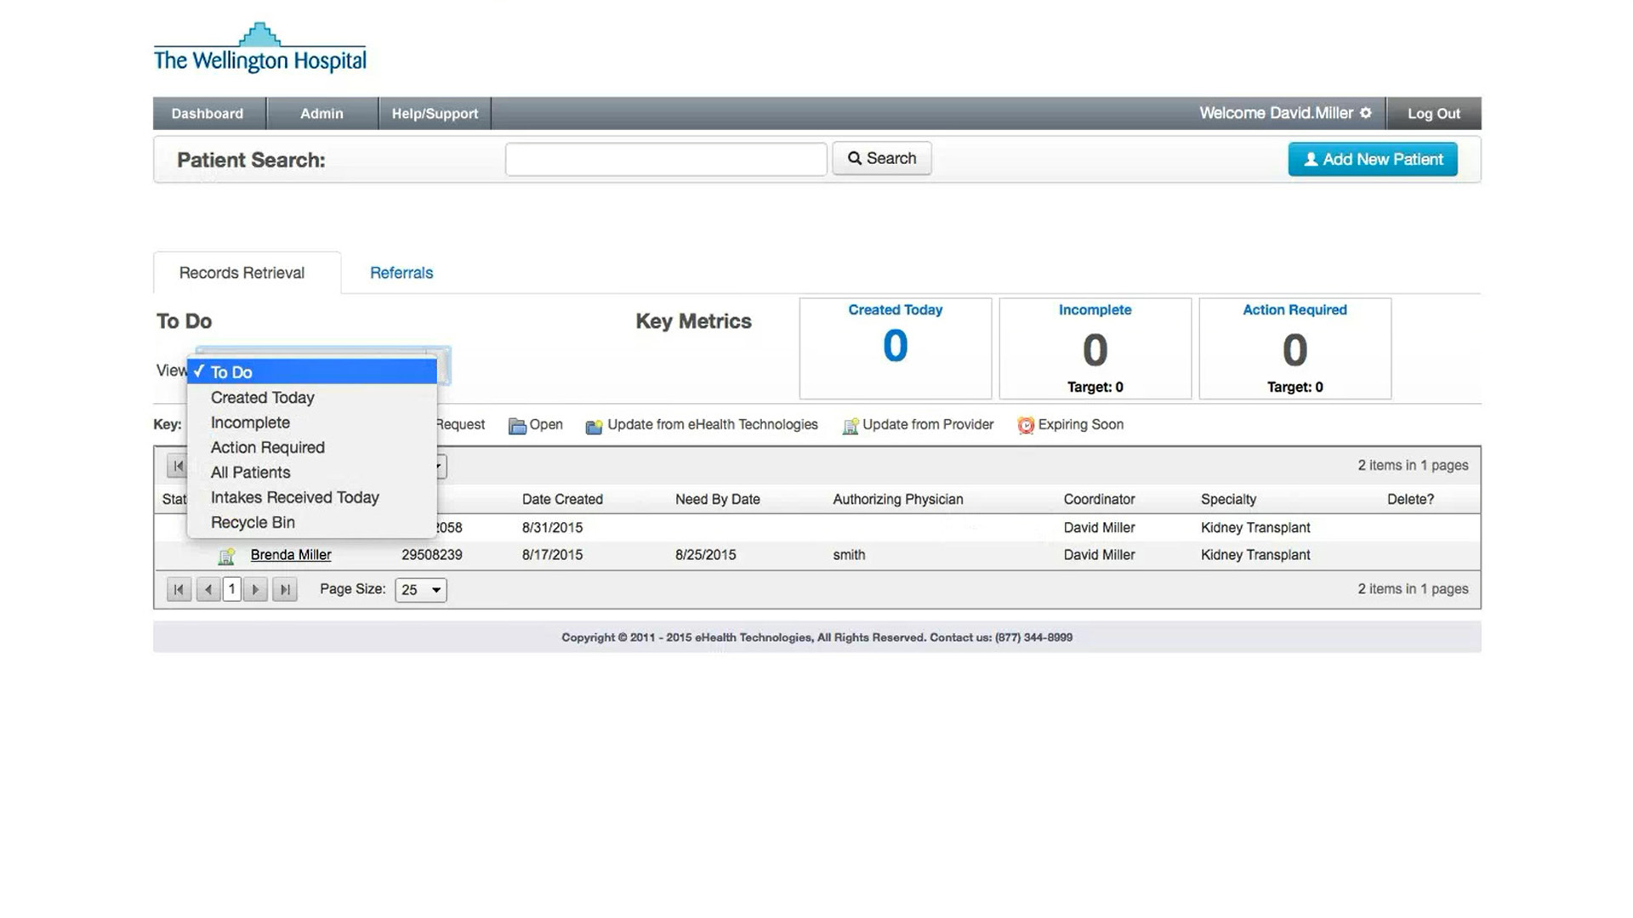
You can also filter the information by choosing from the different view options of: To Do
Includes any action required patients, or updated patients who have new records or messages available

Slide 46
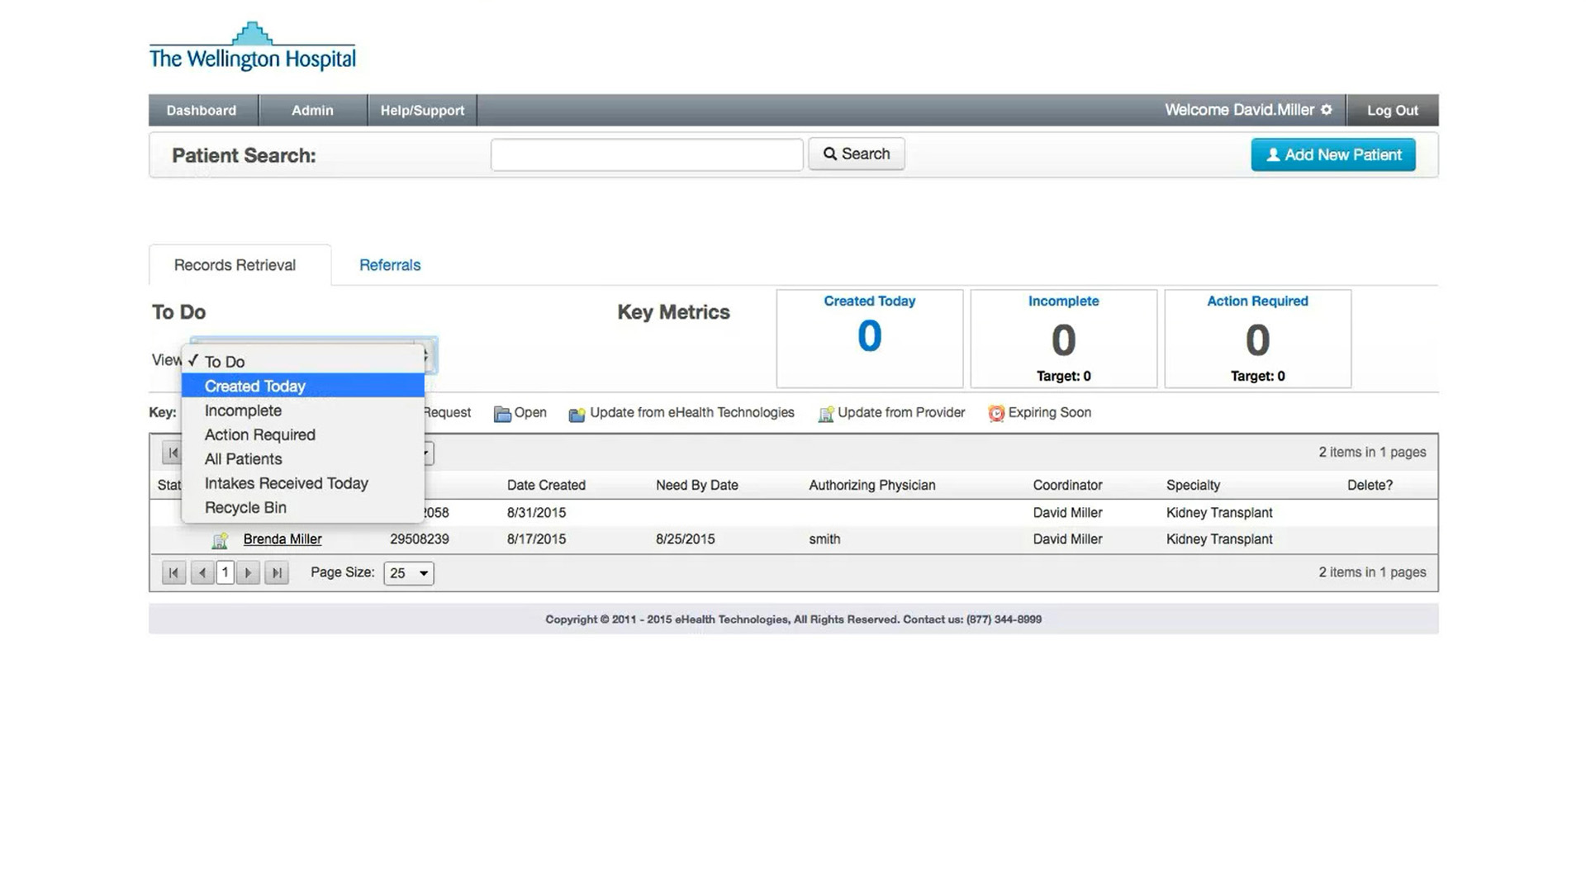
You can also filter the information by choosing from the different view options of: Created Today
Shows any patient record requests submitted to the RMS portal today

Slide 47
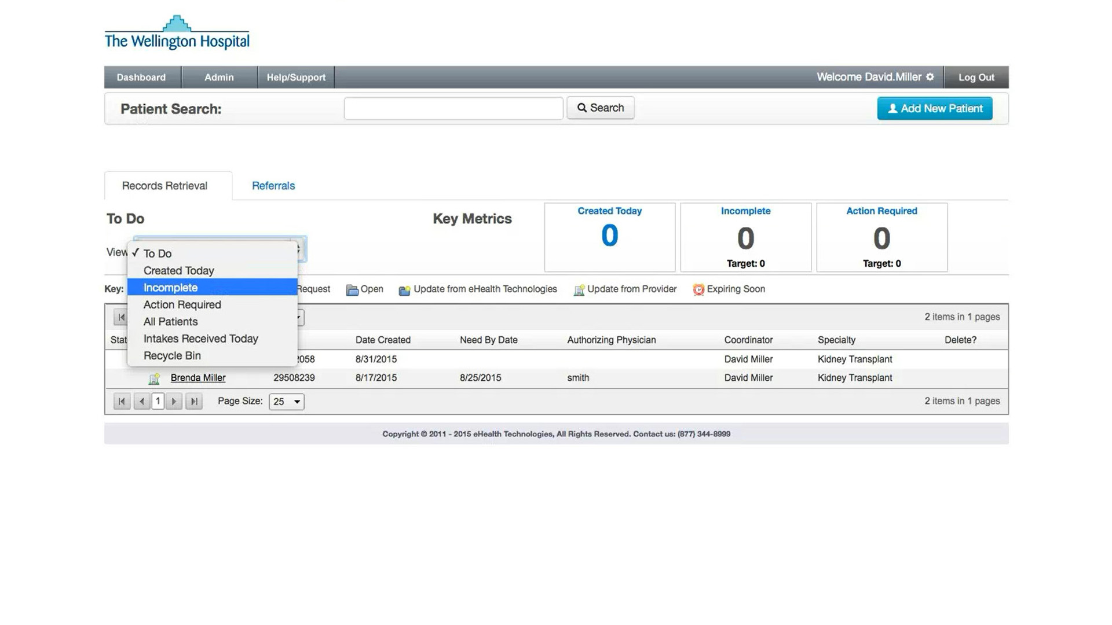
You can also filter the information by choosing from the different view options of: Incomplete
Shows all requests started, but incomplete

Slide 48
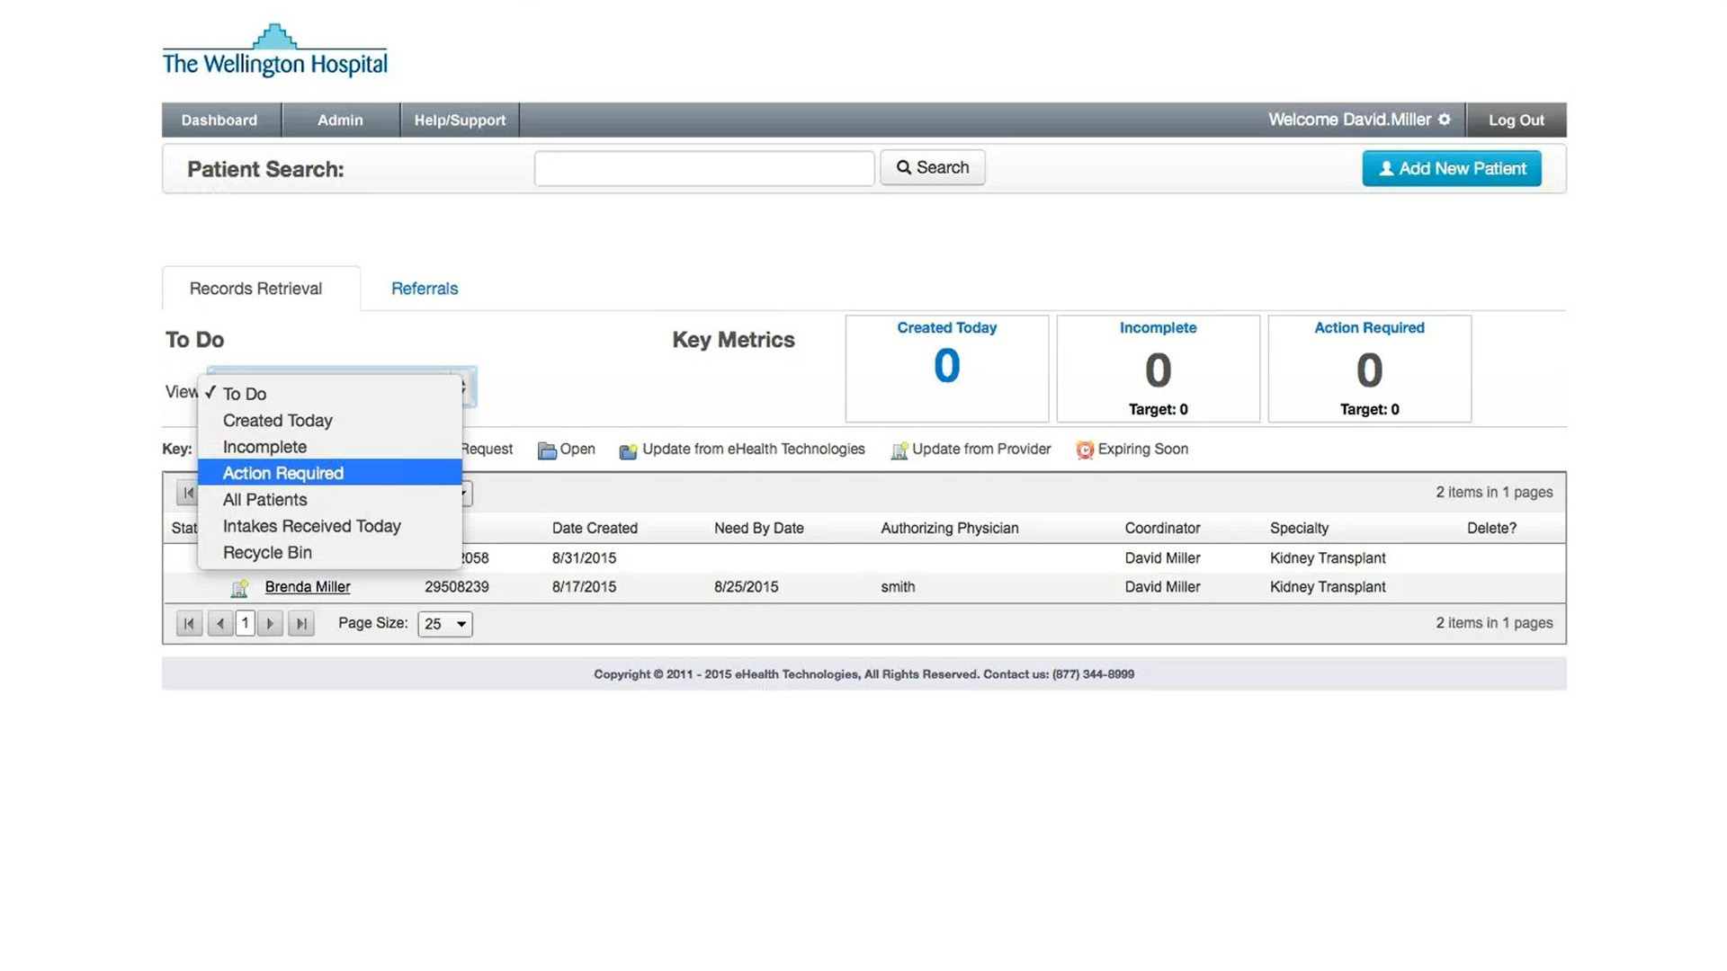
You can also filter the information by choosing from the different view options of: Action Required
Shows only patients’ record requests where an action is required (patients where eHealth Technologies has hit a stopping point on a request)

Slide 49
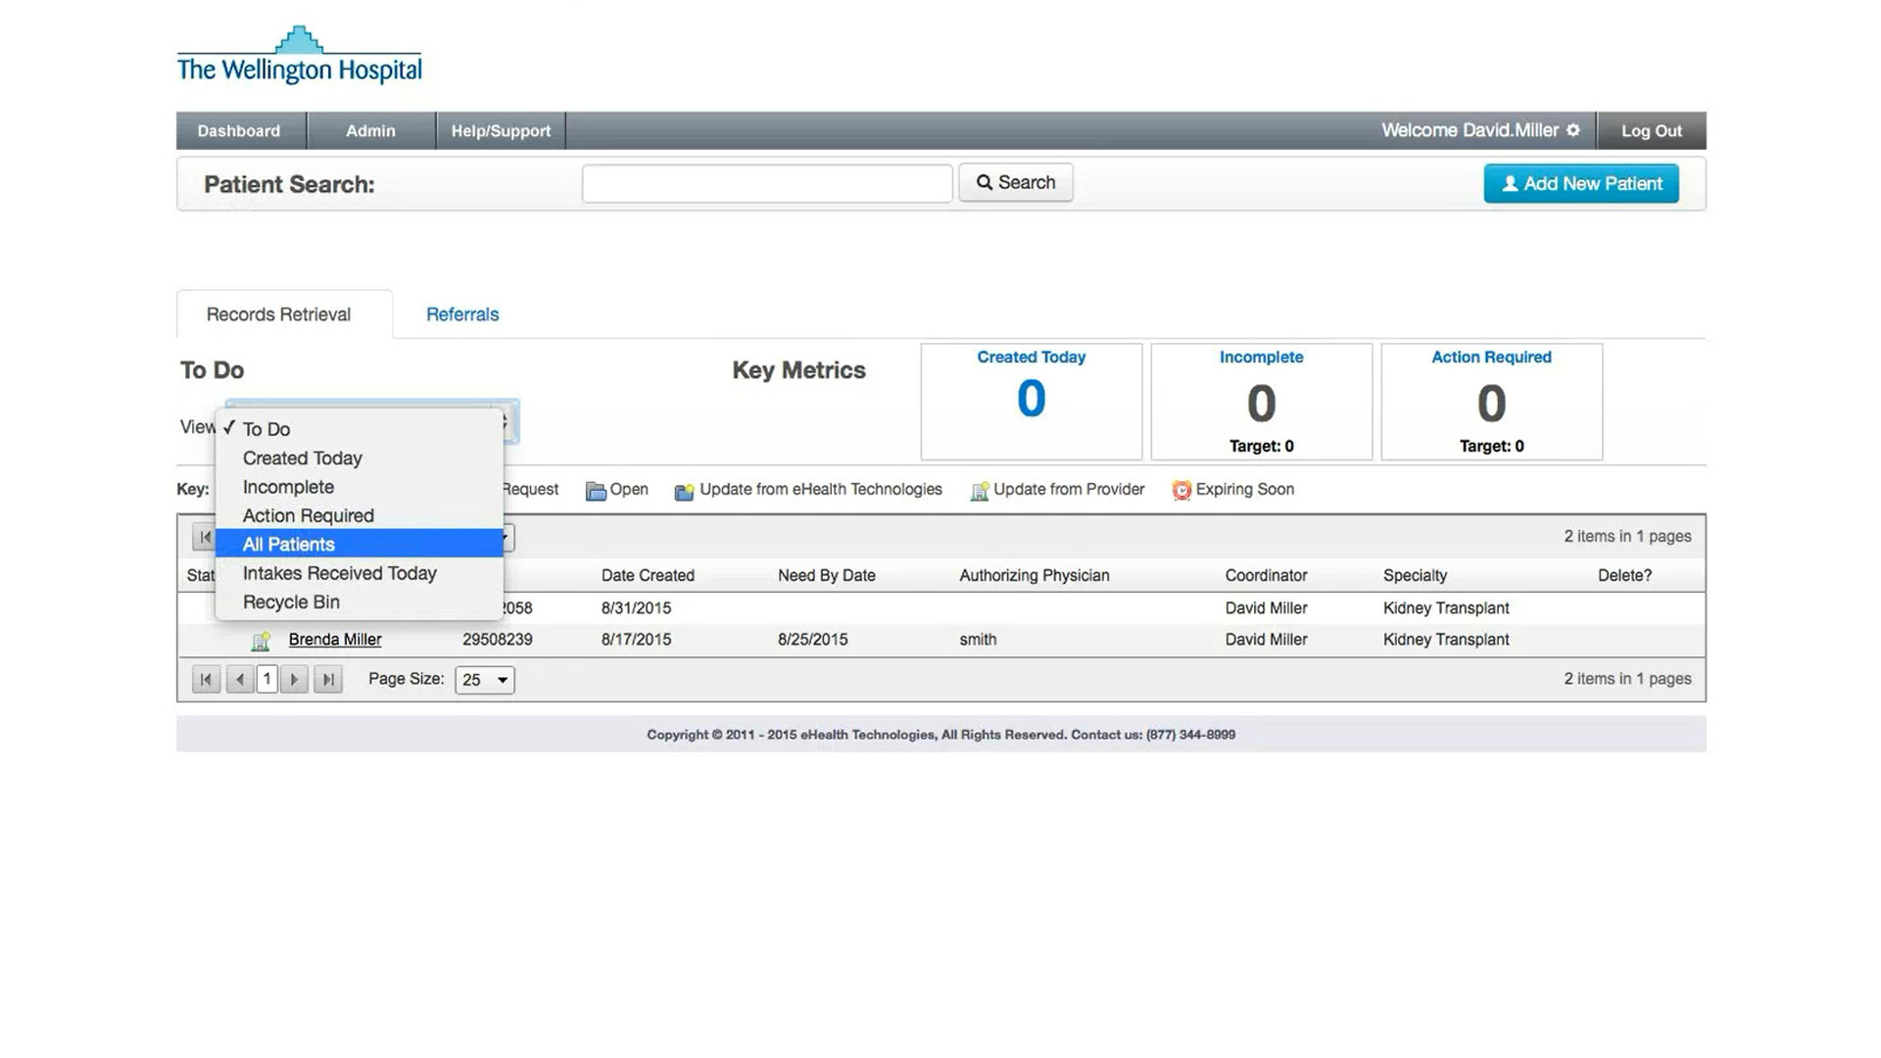
You can also filter the information by choosing from the different view options of: All Patients
Shows the last 90 days of requests

Slide 50
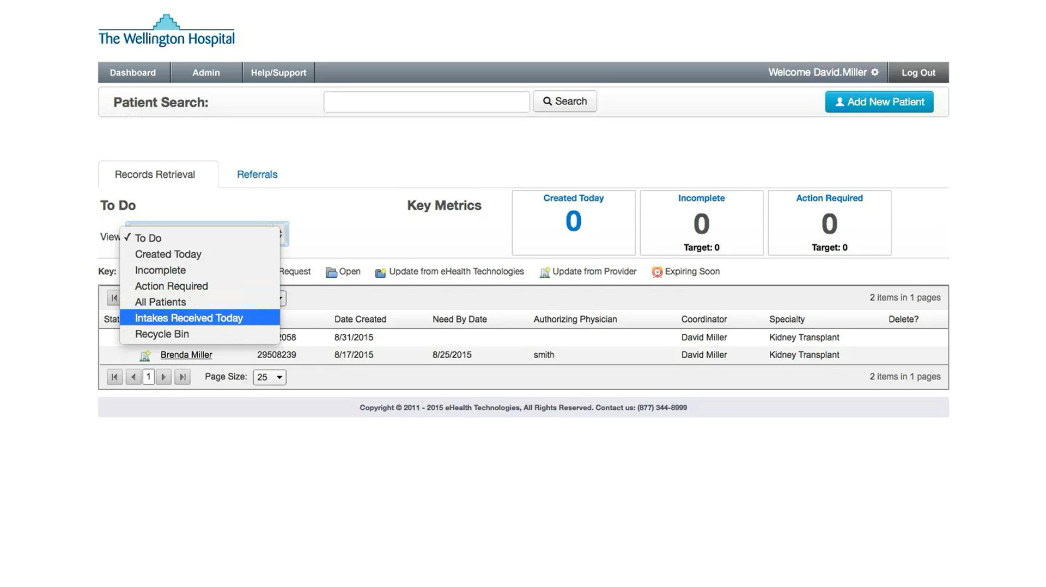
You can also filter the information by choosing from the different view options of: Intakes Received Today
Are for customers with Health Level Seven International (HL7) Admissions, Discharge, and Transfer (ADT) feed integrations

Slide 51
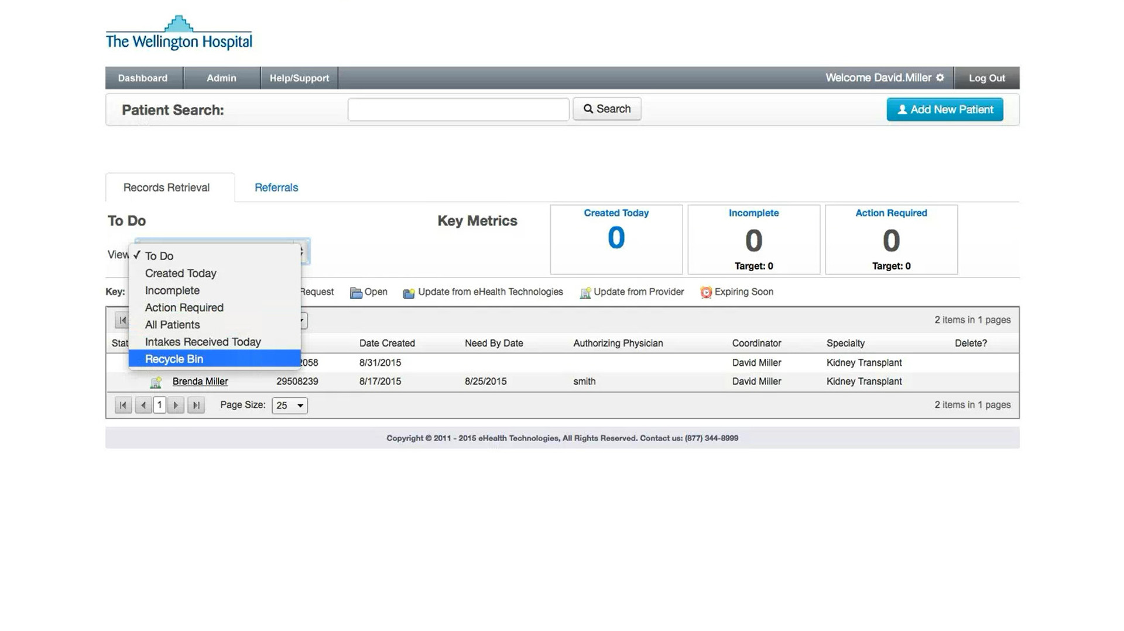
You can also filter the information by choosing from the different view options of: Recycle Bin
This will show all patients’ record requests deleted within the past 30 days
NOTE: as with patients shown in the Incomplete view, you can pick up and continue working on patients listed in the Recycle Bin view

Slide 52
The Patient Search field allows you to search for a patient using stored information. You can search by various keys including:

Slide 53
The Patient Search field allows you to search for a patient using stored information. You can search by various keys including:
Patient Name

Slide 54
The Patient Search field allows you to search for a patient using stored information. You can search by various keys including:
Patient Name
Date of Birth

Slide 55
The Patient Search field allows you to search for a patient using stored information. You can search by various keys including:
Patient Name
Date of Birth
Social Security Number

Slide 56
The Patient Search field allows you to search for a patient using stored information. You can search by various keys including:
Patient Name
Date of Birth
Social Security Number
Medical Record Number

Slide 57
To begin a new request, click the Add New Patient button

Slide 58
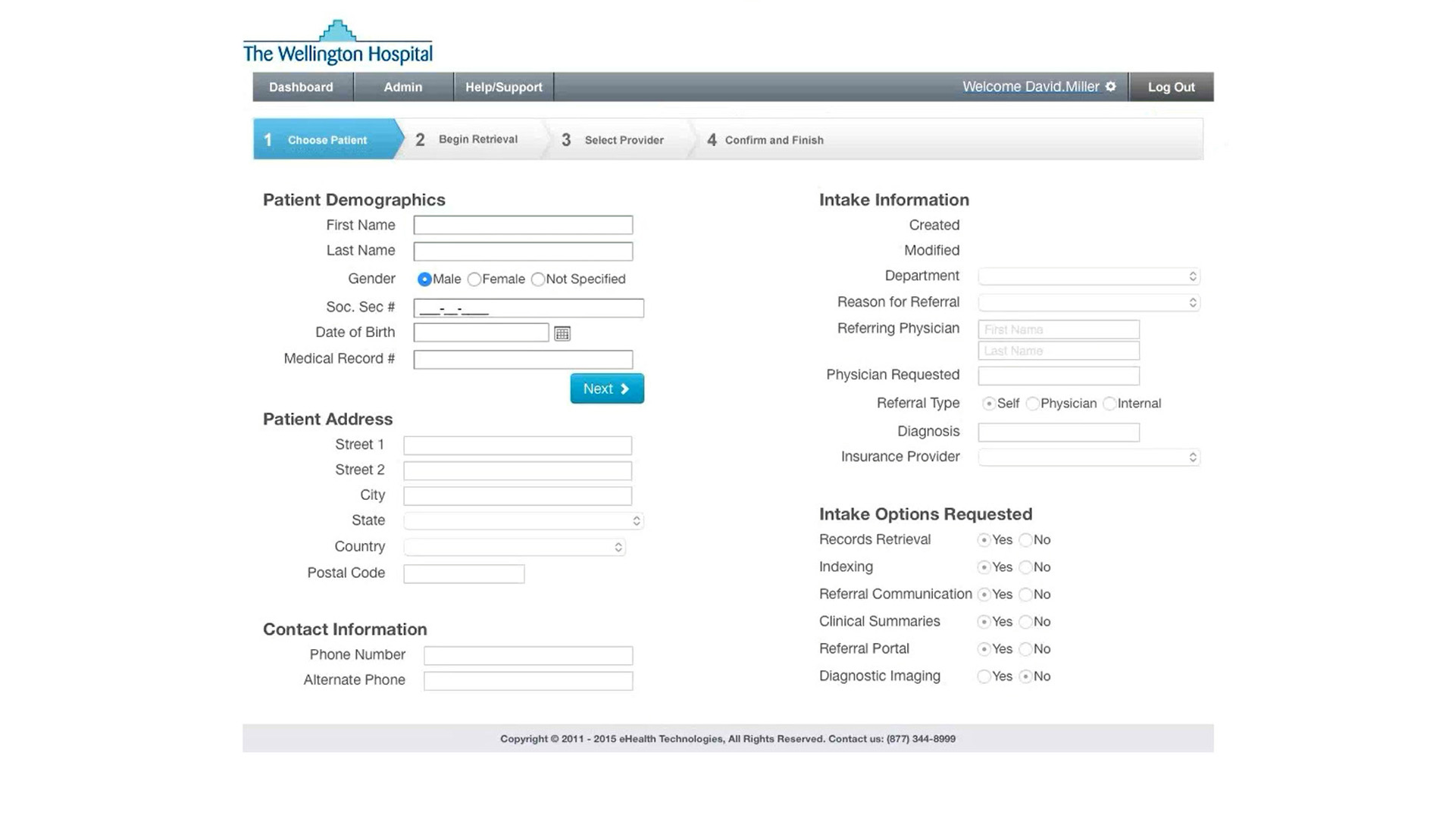
All new requests for records are initiated on this page
Begin by entering the essential patient demographics of:

Slide 59

Begin by entering the essential patient demographics of:
First and Last Name

Slide 60
Begin by entering the essential patient demographics of:
First and Last Name
Gender

Slide 61

Begin by entering the essential patient demographics of:
First and Last Name
Gender
Social Security Number
NOTE: if the patient’s social security number is unavailable, enter all zeros in this field

Slide 62
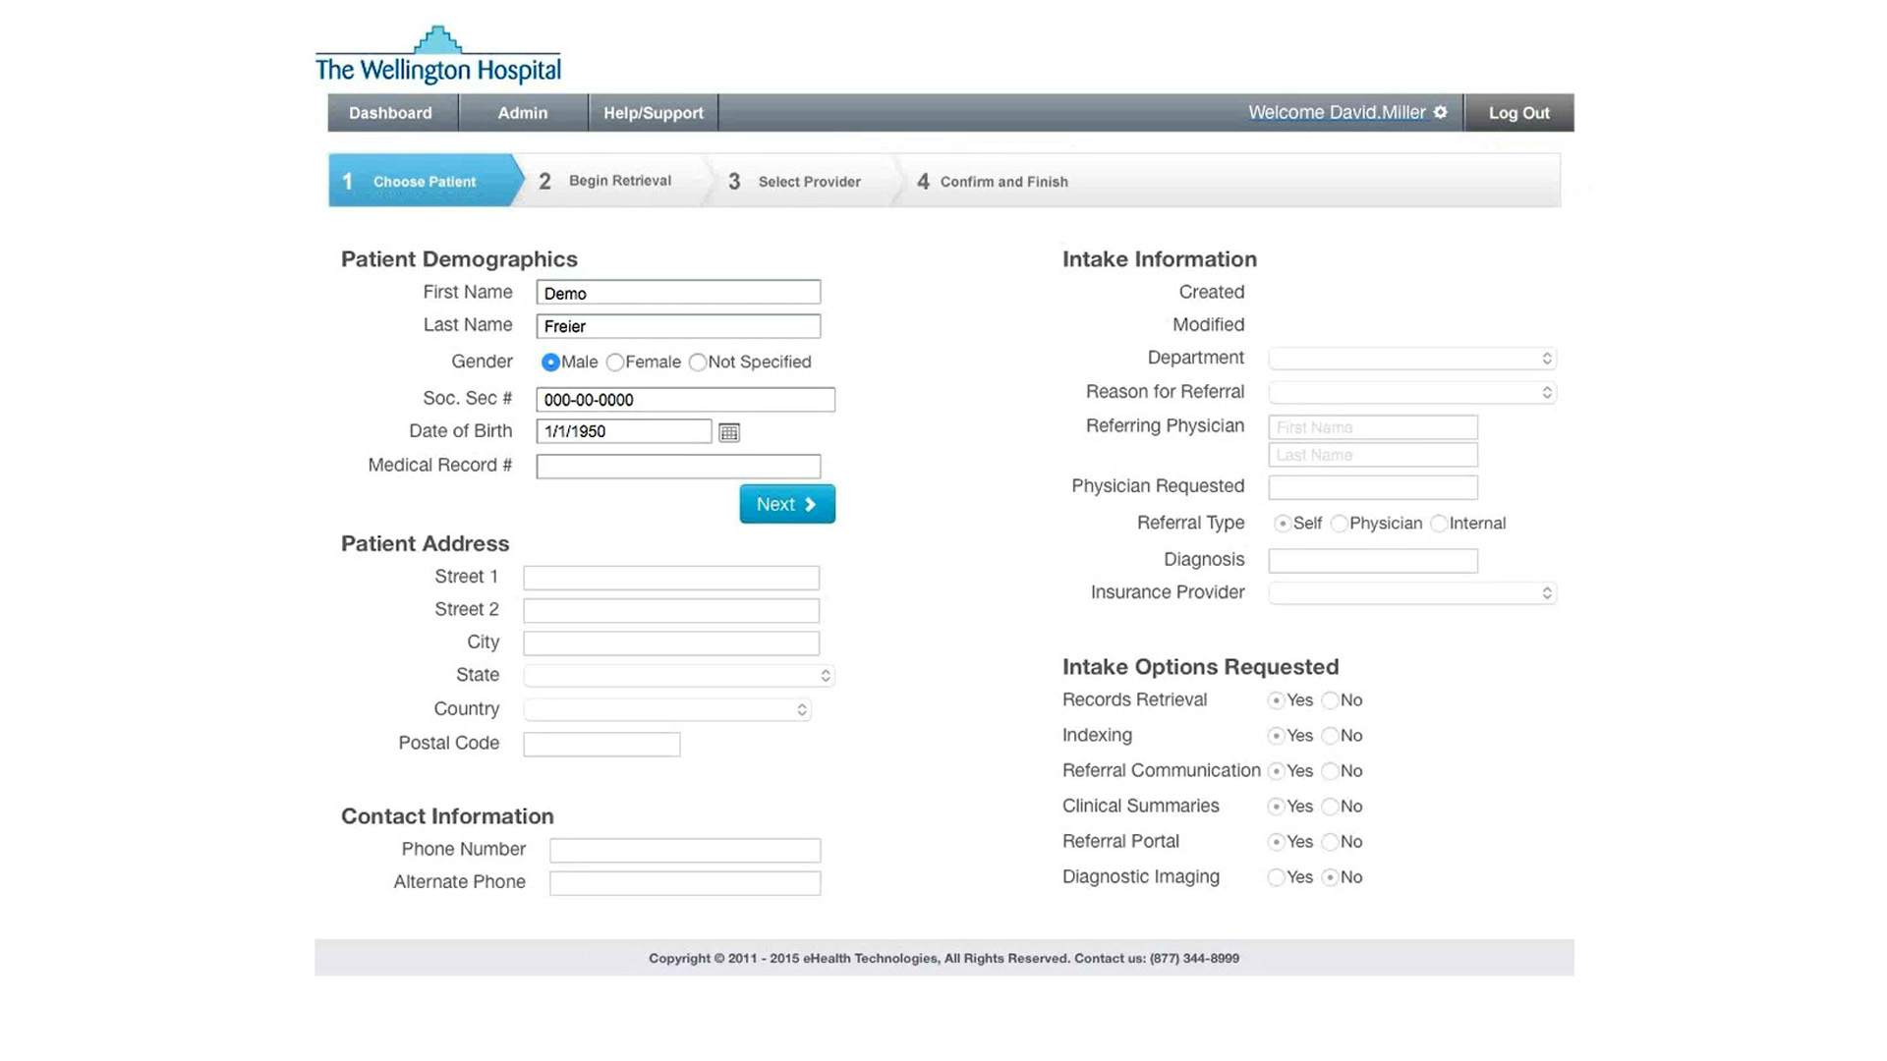
Begin by entering the essential patient demographics of:
First and Last Name
Gender
Social Security Number
Date of Birth

Slide 63
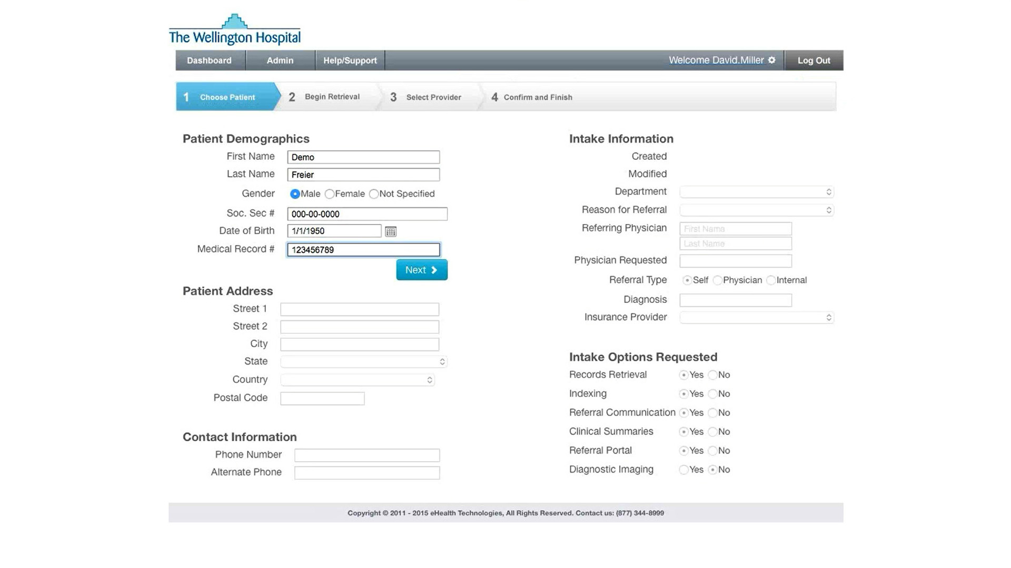
Begin by entering the essential patient demographics of:
First and Last Name
Gender
Social Security Number
Date of Birth
Medical Record Number
NOTE: use the patient’s medical record number associated with your facility

Slide 64
Once the Patient Demographic information has been entered, click the Next button

Slide 65
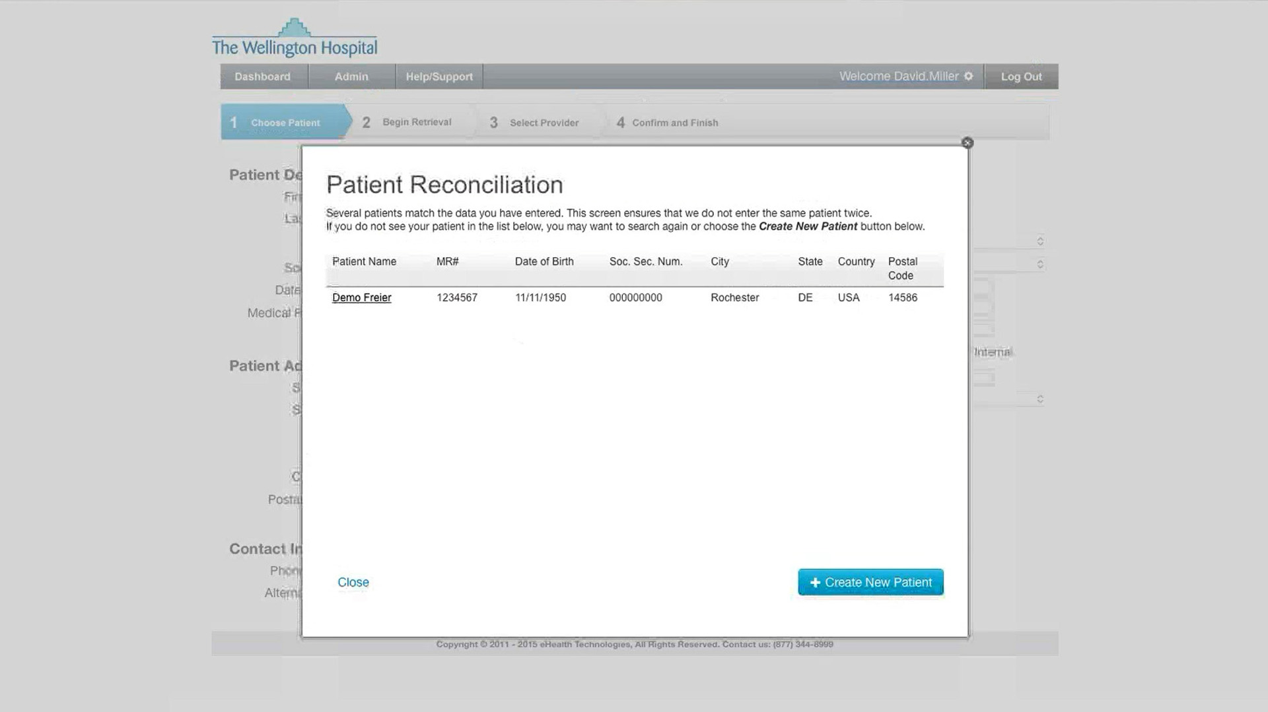
If a patient on this list matches the demographics of the patient you are entering, click on the patient name to continue using that existing patient’s demographic information

Slide 66
If not, click on the Create New Patient button to continue entering patient information

Slide 67
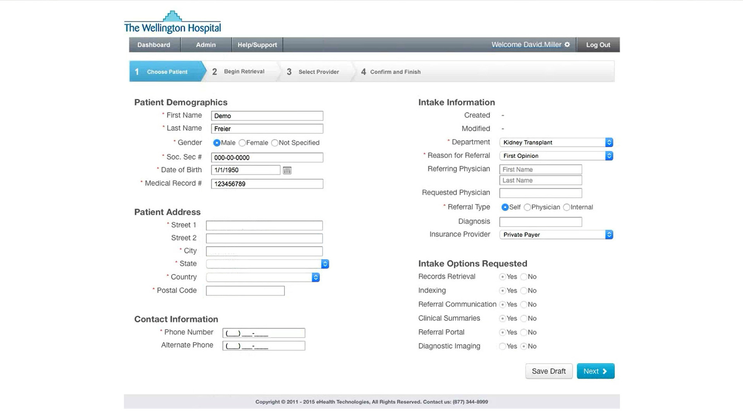
Complete the Patient Address, and Contact Information areas

Slide 68
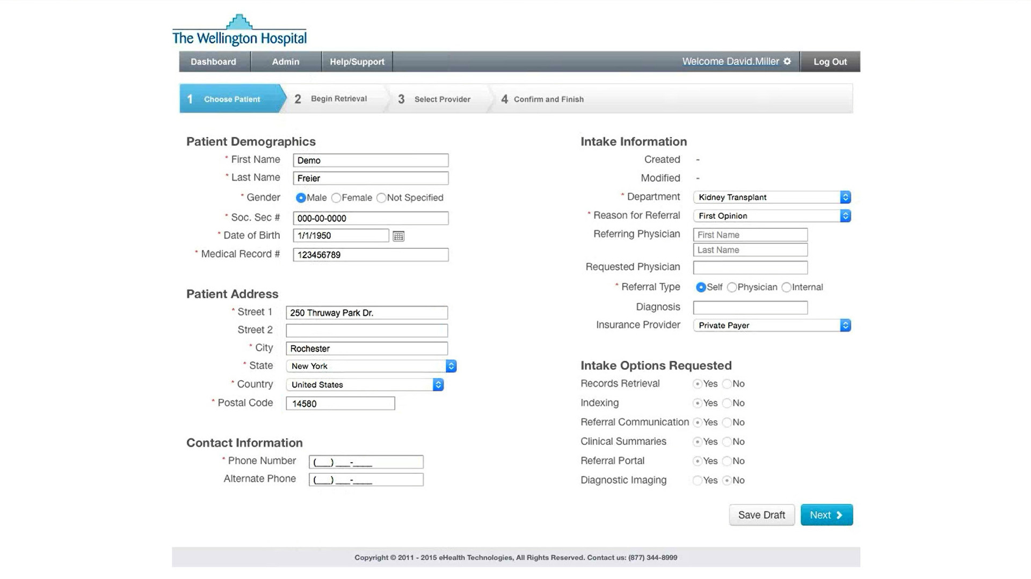
Complete the Patient Address, and Contact Information areas

Slide 69

Complete the Patient Address, and Contact Information areas

Slide 70
Complete the Patient Address, and Contact Information areas
NOTE: all fields shown with an asterisk are required

Slide 72
Now go on to the next program module:
(or go back to review a previous module)
INTRODUCTION
PATIENT DEMOGRAPHICS
PATIENT INTAKE OPTIONS
IDENTIFYING RECORDS PROVIDERS
MANAGE PATIENT TO-DO LIST

Slide 74

Now we will discuss the RMS intake information functional area

Slide 75
At this point, we’ve entered the Patient Demographics. We now need to enter information that will relate the patient to physicians and events at your facility

Slide 76
At this point, we’ve entered the Patient Demographics. We now need to enter information that will relate the patient to physicians and events at your facility
NOTE: all fields shown with an asterisk are required

Slide 77
Standardizing the formats of data entry across your department for freeform text fields will help with the consistency of reporting and data analytics
NOTE: you can click the Save Draft button at any time during the process to store the current state of the record

Slide 78
Select the Department to indicate what service line the patient is being scheduled under

Slide 79
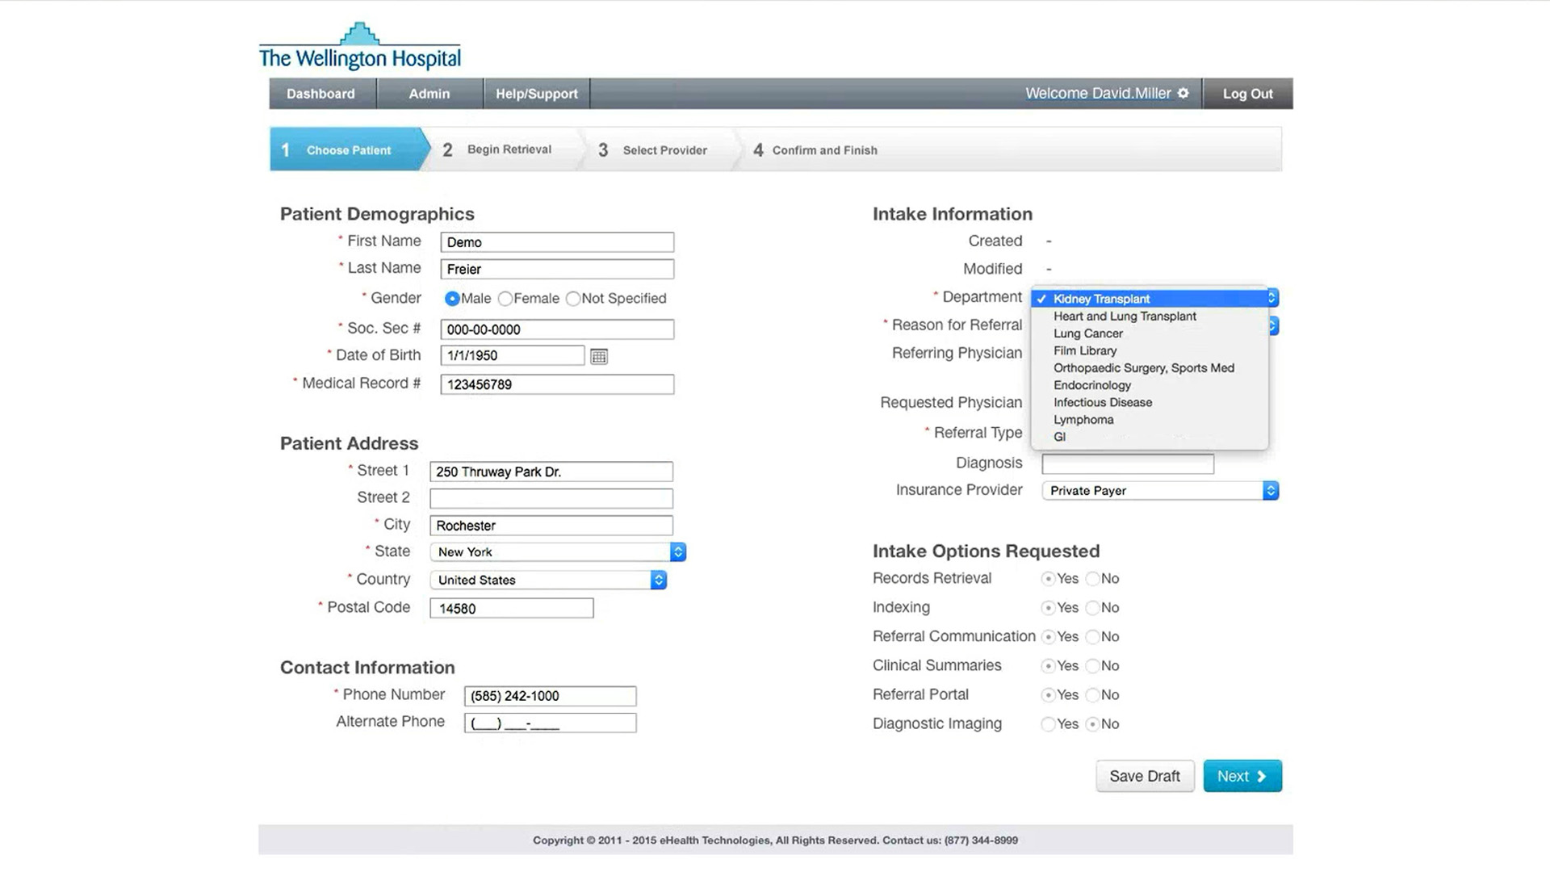
Select the Department to indicate what service line the patient is being scheduled under

Slide 80
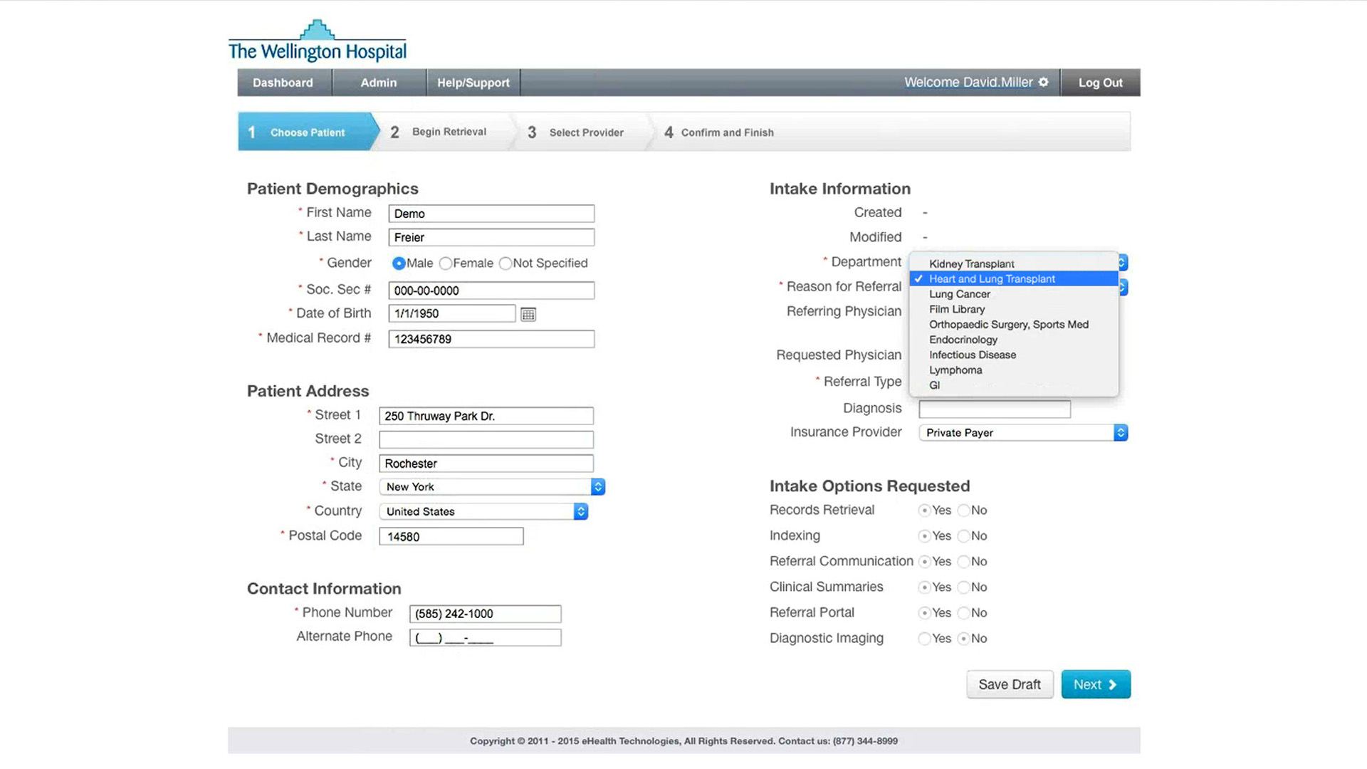
Select the Department to indicate what service line the patient is being scheduled under

Slide 81
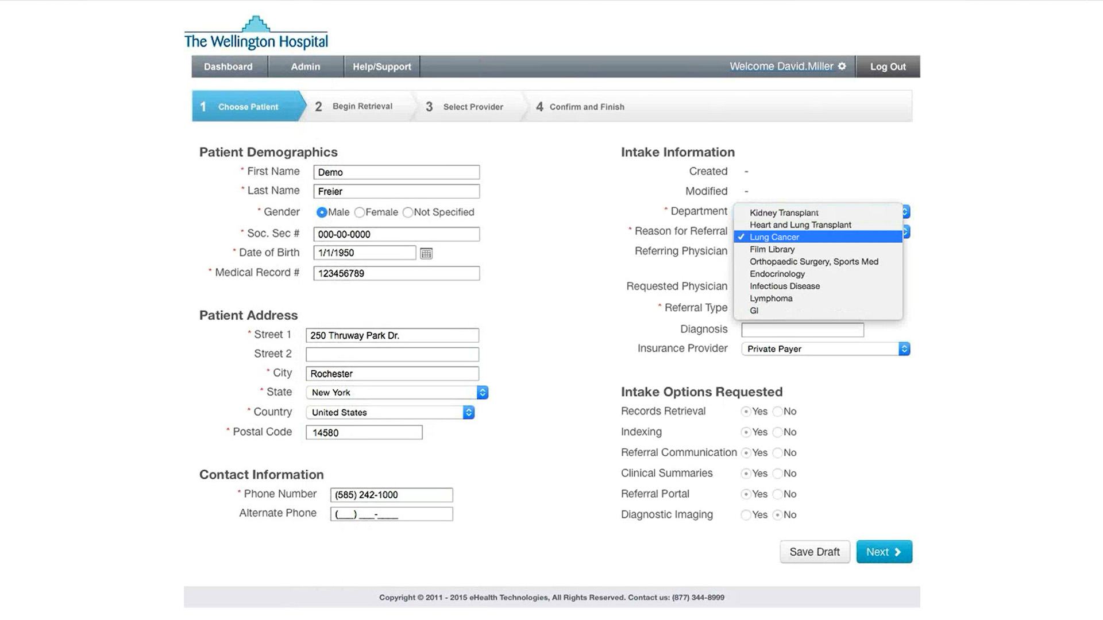
Select the Department to indicate what service line the patient is being scheduled under
NOTE: service lines listed in this dropdown box have been predetermined by your administrator

Slide 82
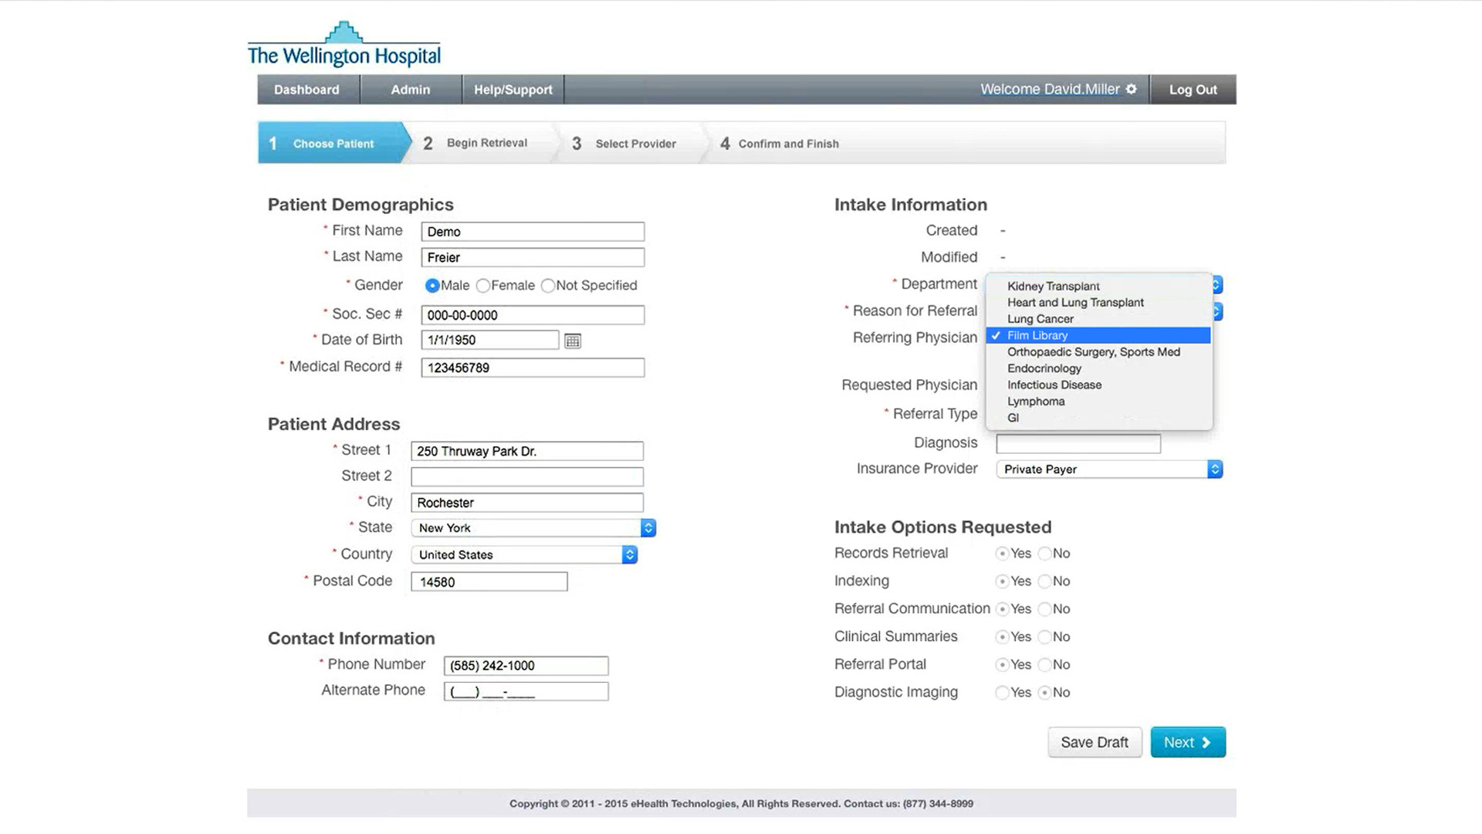
Select the Department to indicate what service line the patient is being scheduled under
NOTE: service lines listed in this dropdown box have been predetermined by your administrator

Slide 83

Select the Department to indicate what service line the patient is being scheduled under
NOTE: service lines listed in this dropdown box have been predetermined by your administrator

Slide 84
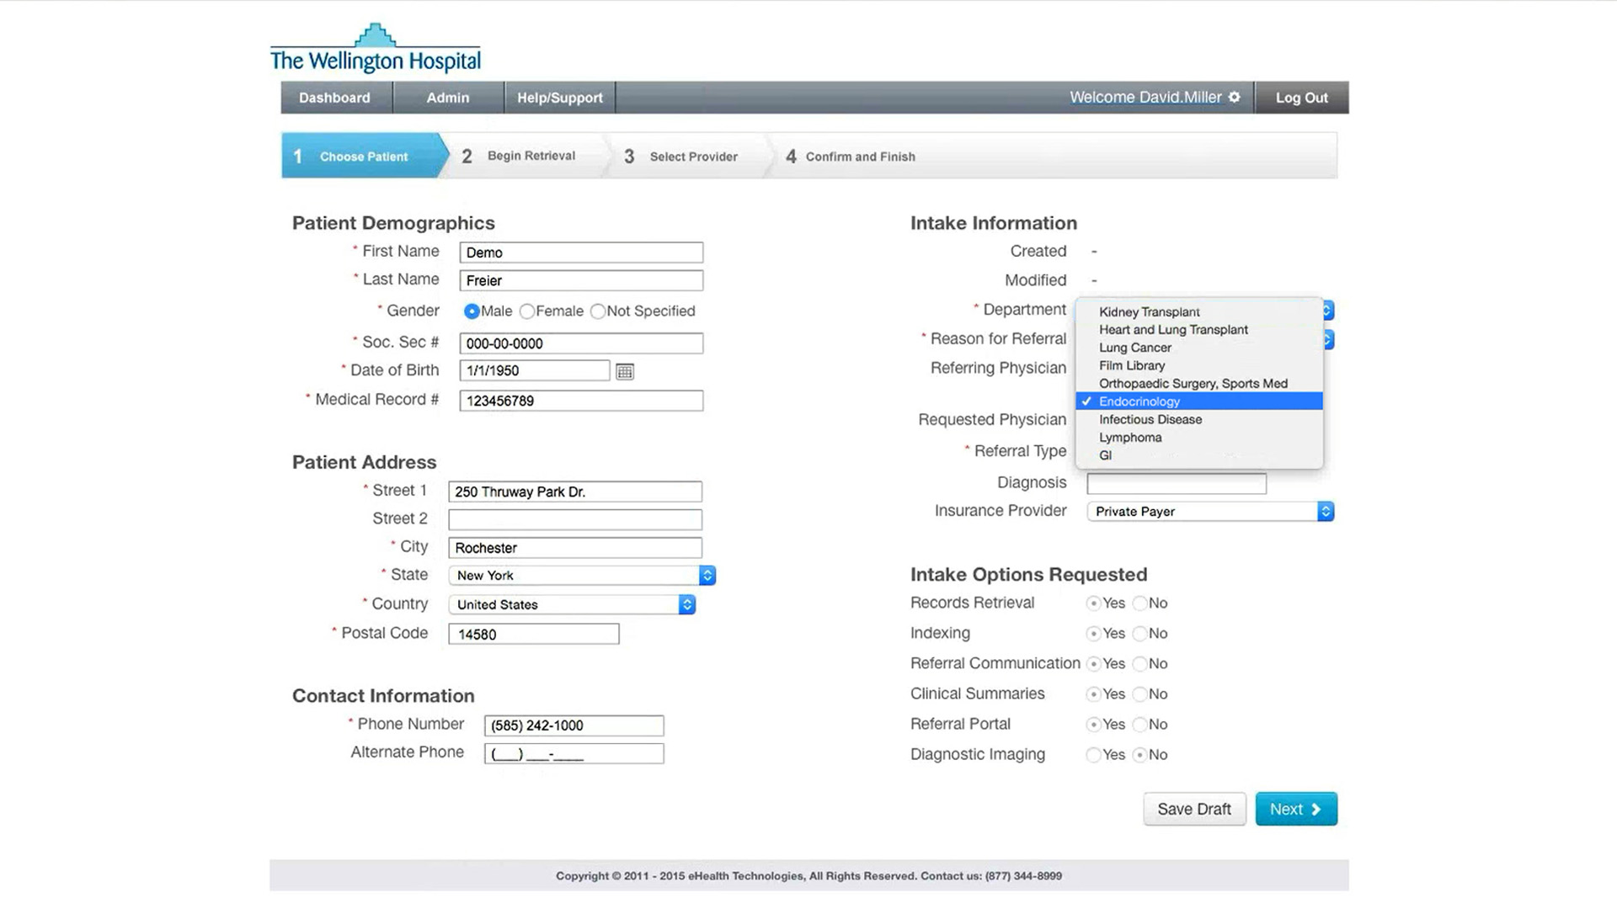
Select the Department to indicate what service line the patient is being scheduled under
NOTE: service lines listed in this dropdown box have been predetermined by your administrator

Slide 85
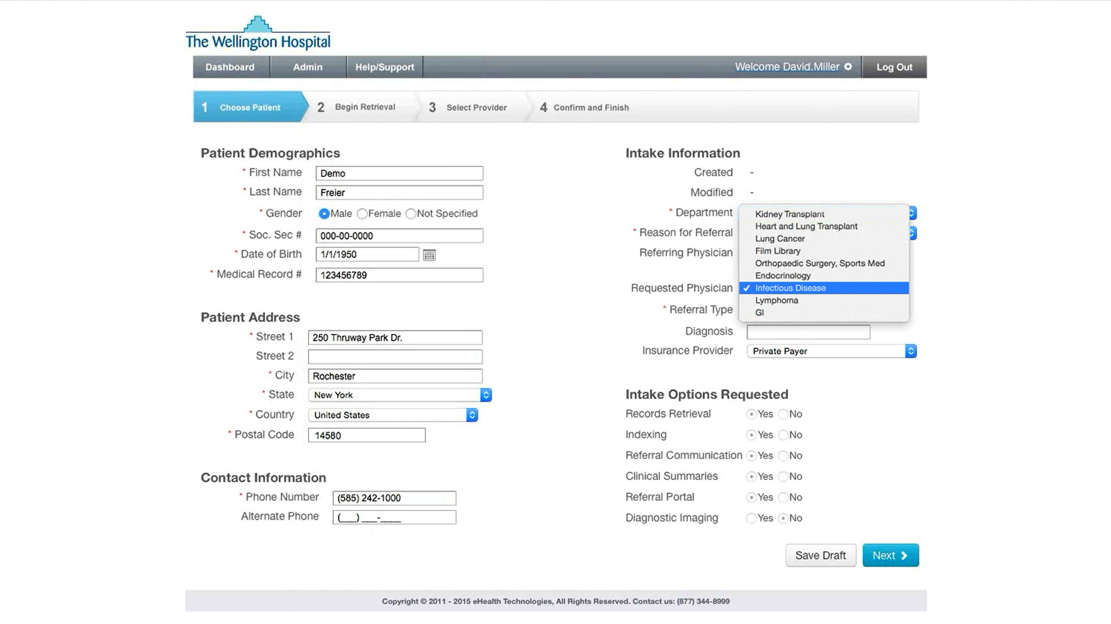
Select the Department to indicate what service line the patient is being scheduled under
NOTE: service lines listed in this dropdown box have been predetermined by your administrator

Slide 86
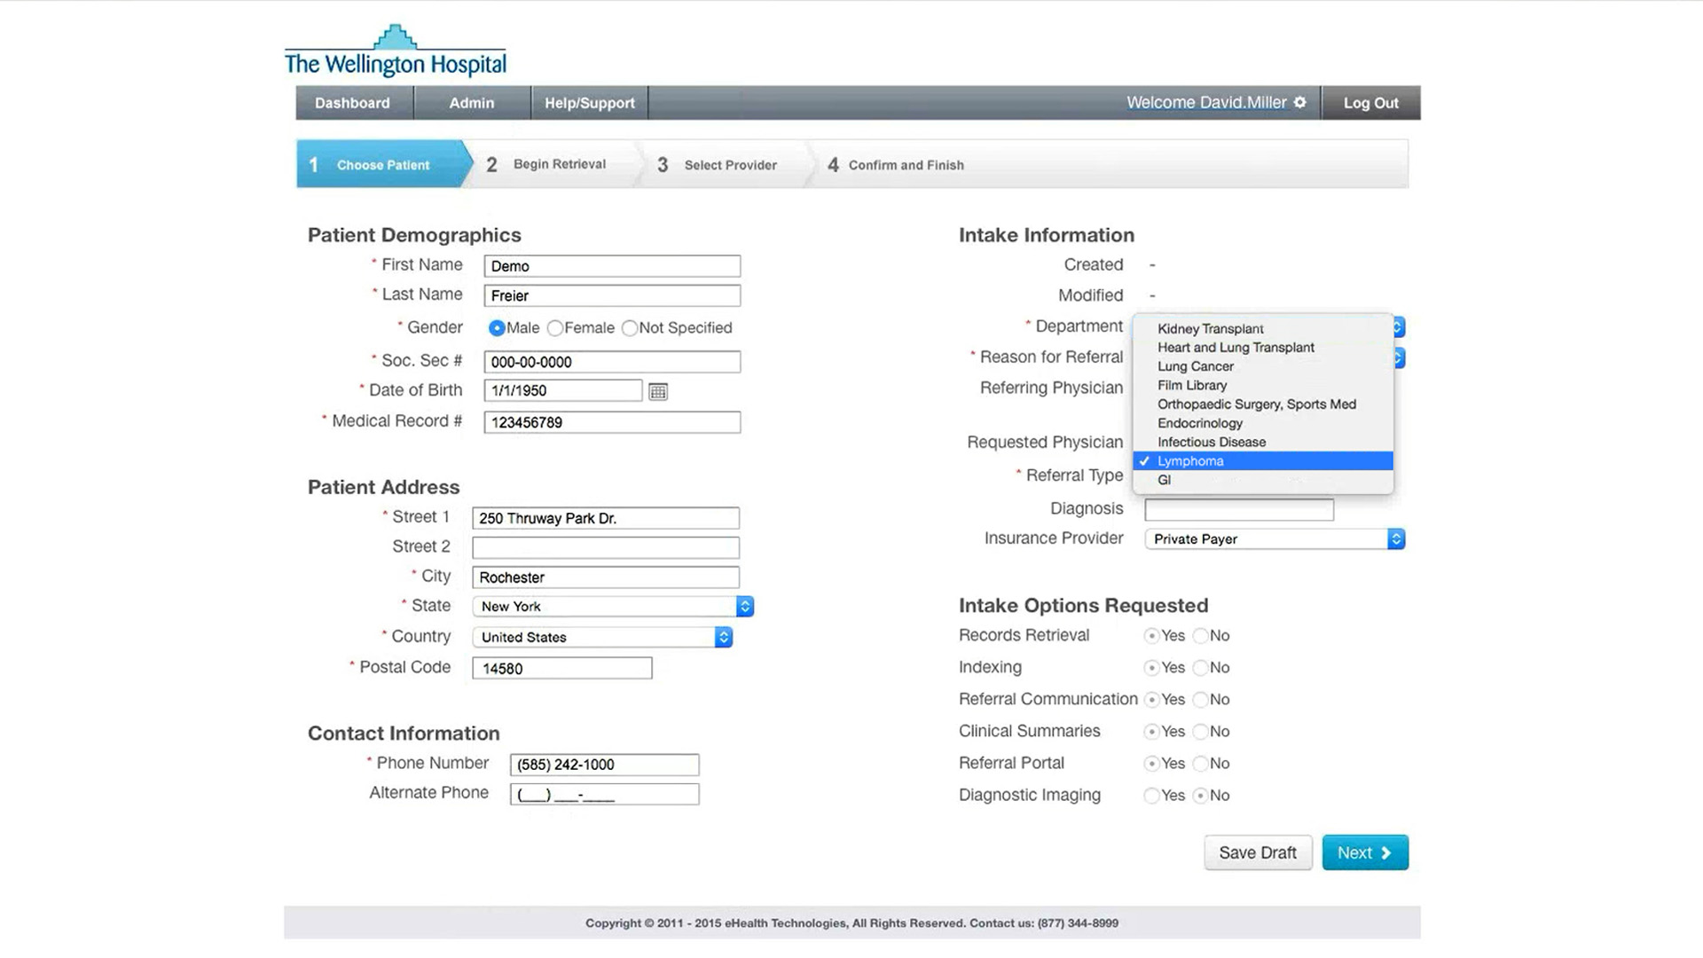
Select the Department to indicate what service line the patient is being scheduled under
NOTE: service lines listed in this dropdown box have been predetermined by your administrator

Slide 87
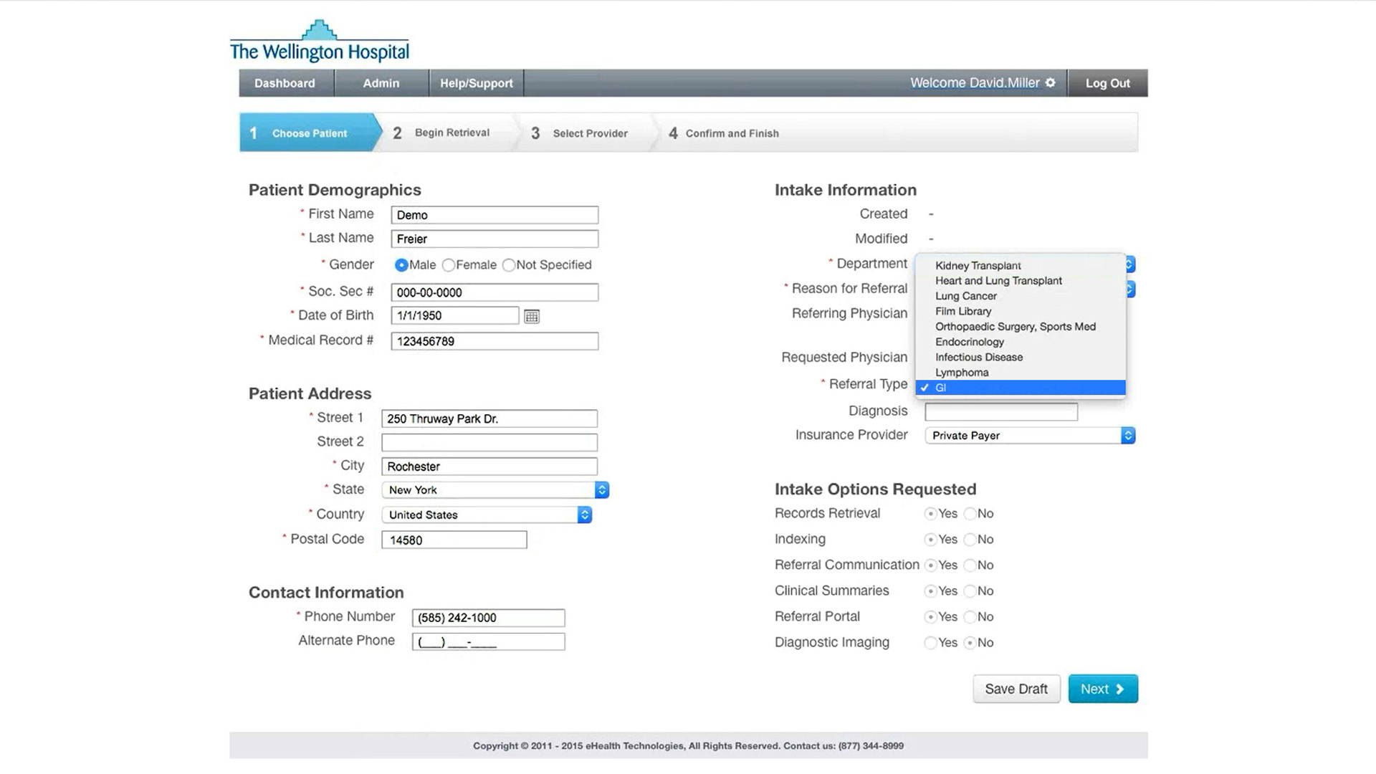
Select the Department to indicate what service line the patient is being scheduled under
NOTE: service lines listed in this dropdown box have been predetermined by your administrator

Slide 88
Select the Department to indicate what service line the patient is being scheduled under
NOTE: service lines listed in this dropdown box have been predetermined by your administrator

Slide 89

Next, select an option from the Reason for Referral dropdown. This captures why the patient is coming to your facility

Slide 90
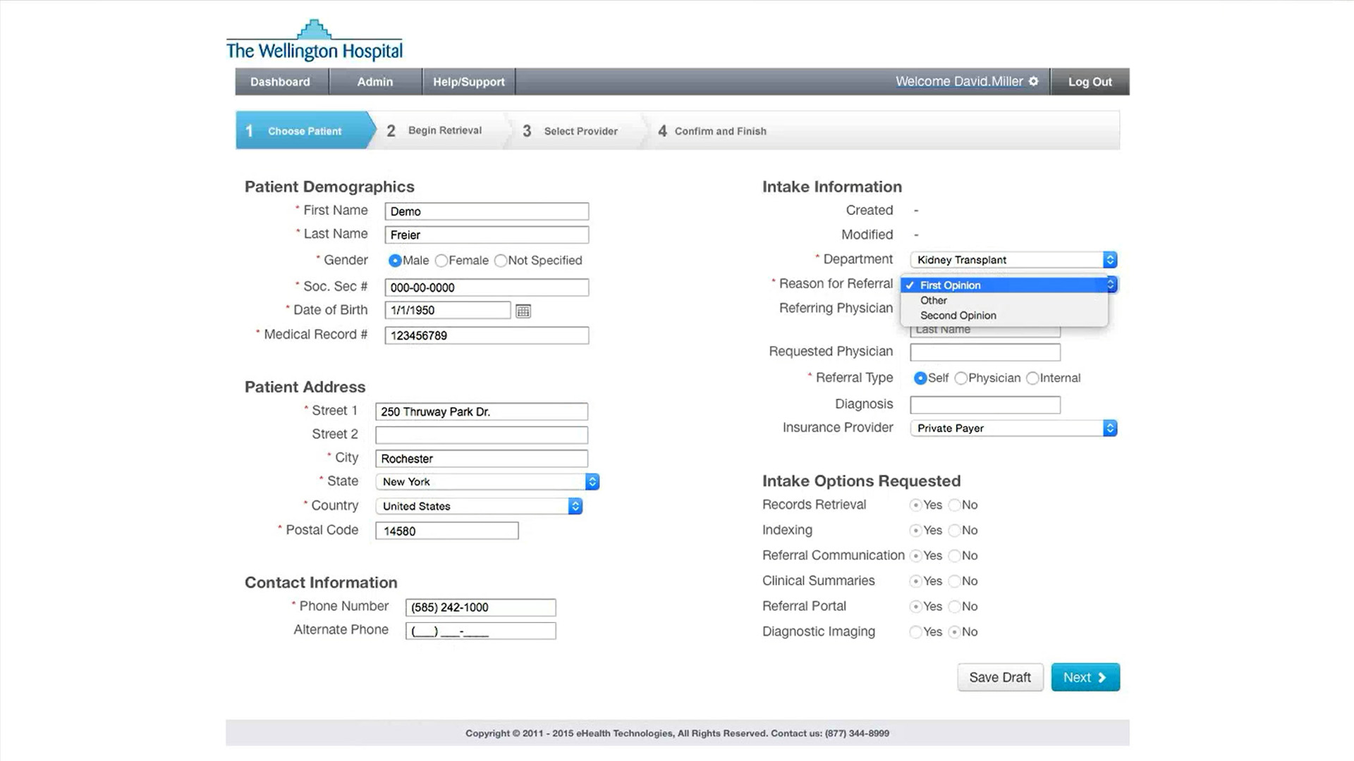
Next, select an option from the Reason for Referral dropdown. This captures why the patient is coming to your facility

Slide 91
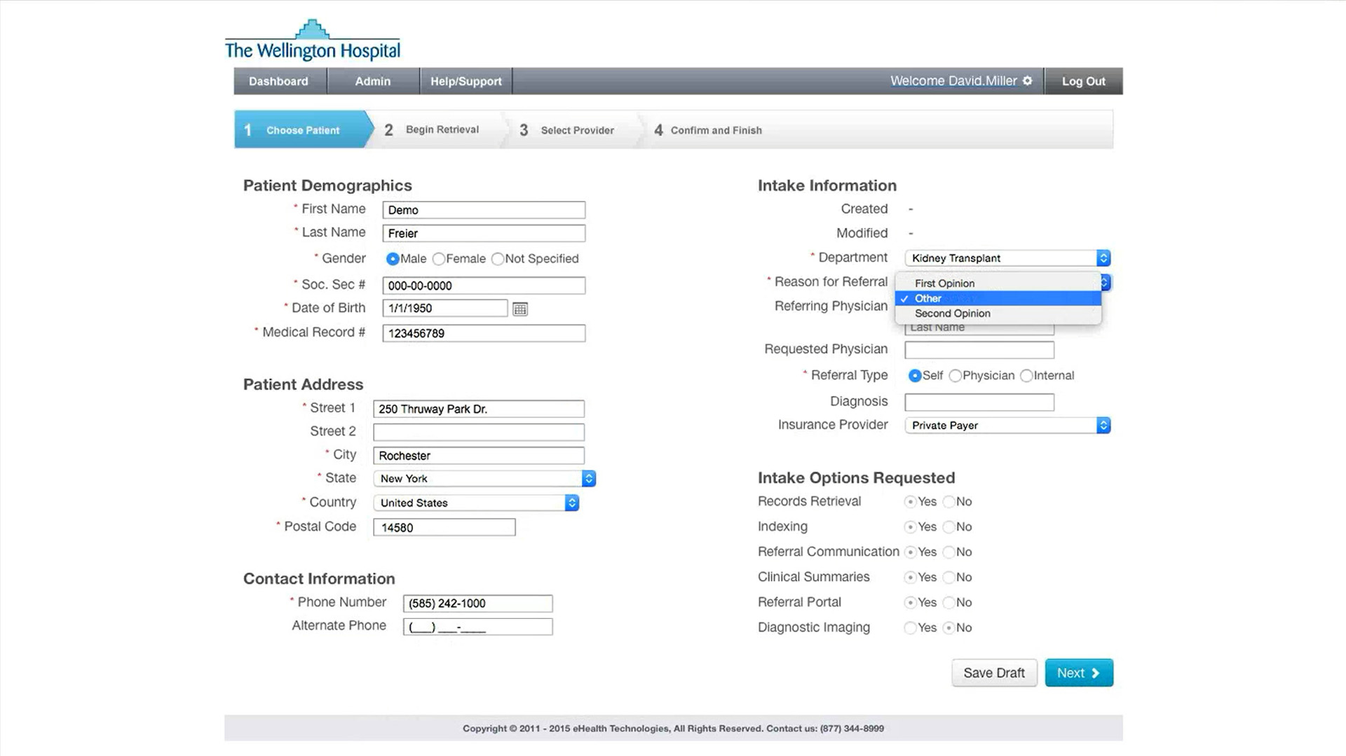
Next, select an option from the Reason for Referral dropdown. This captures why the patient is coming to your facility

Slide 92

Next, select an option from the Reason for Referral dropdown. This captures why the patient is coming to your facility

Slide 93
Next, select an option from the Reason for Referral dropdown. This captures why the patient is coming to your facility

Slide 94
The Referring Physician specifies the provider who referred the patient to your facility

Slide 95
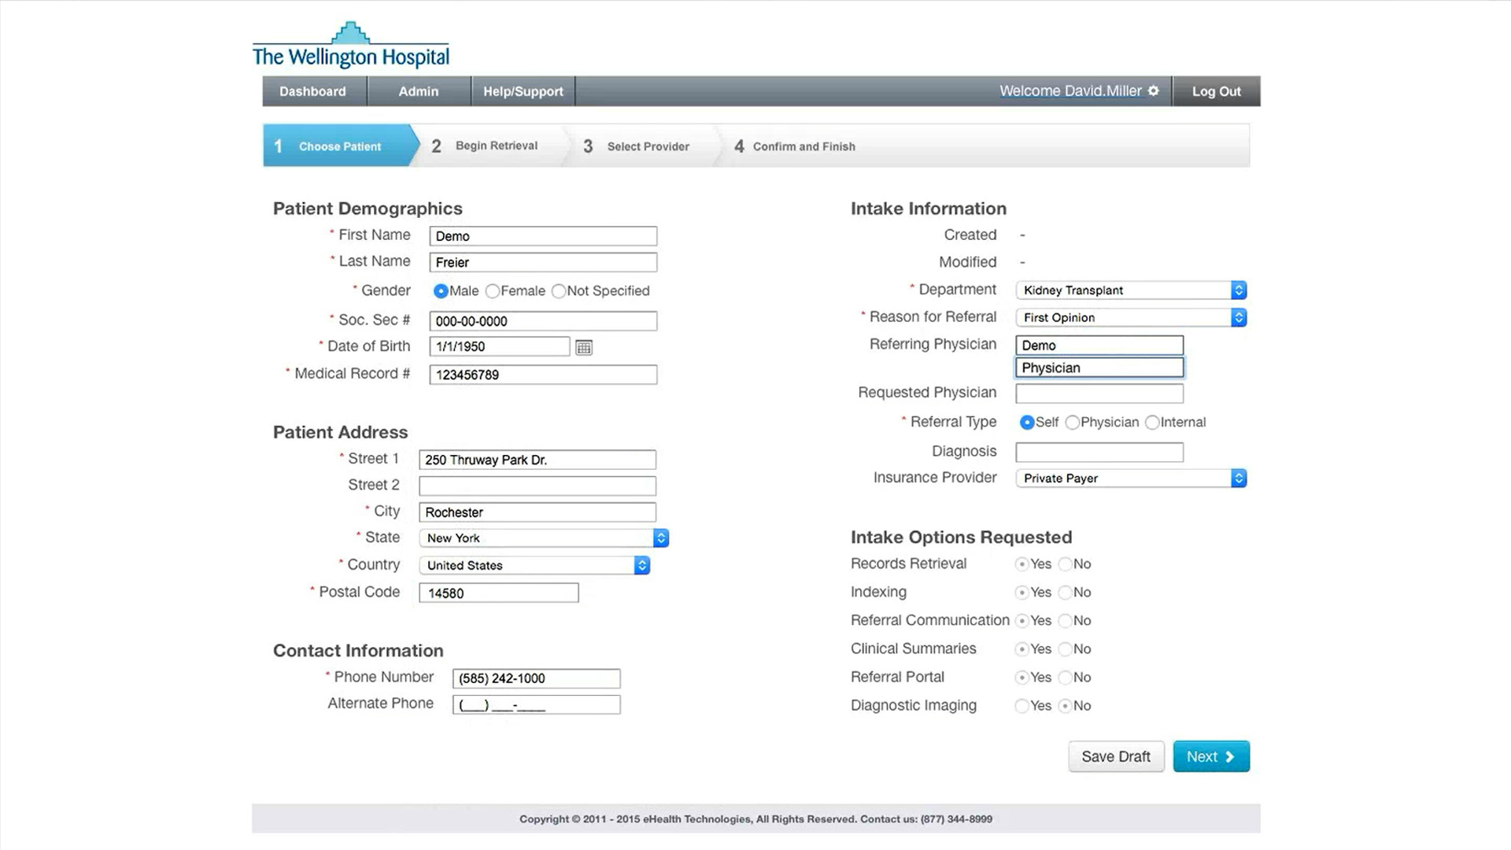
The Referring Physician specifies the provider who referred the patient to your facility

Slide 96
If the patient has asked to be seen by a specific physician at your facility, enter that name in the Requested Physician field

Slide 97
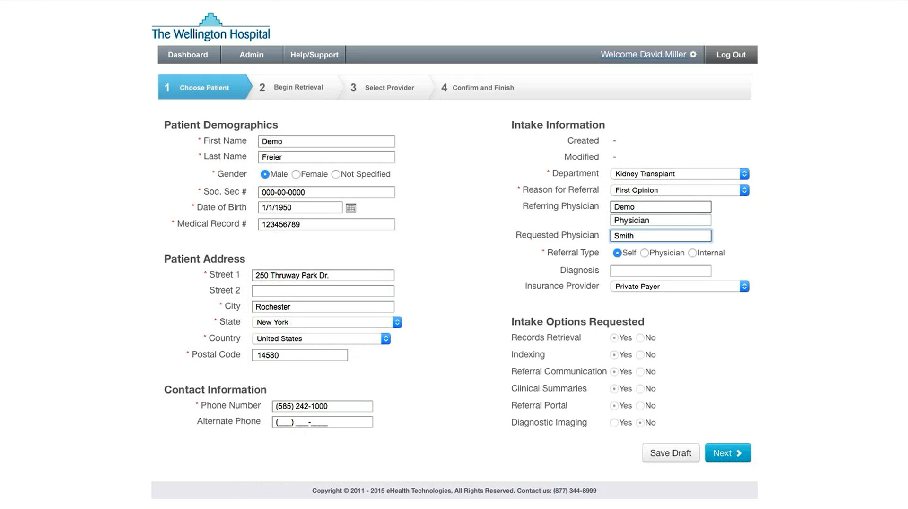
If the patient has asked to be seen by a specific physician at your facility, enter that name in the Requested Physician field

Slide 98
Next, select from the available Referral Types:

Slide 99
Next, select from the available Referral Types:
Self

Slide 100

Next, select from the available Referral Types:
Self
Physician (external)

Slide 101

Next, select from the available Referral Types:
Self
Physician (external)
Internal

Slide 102
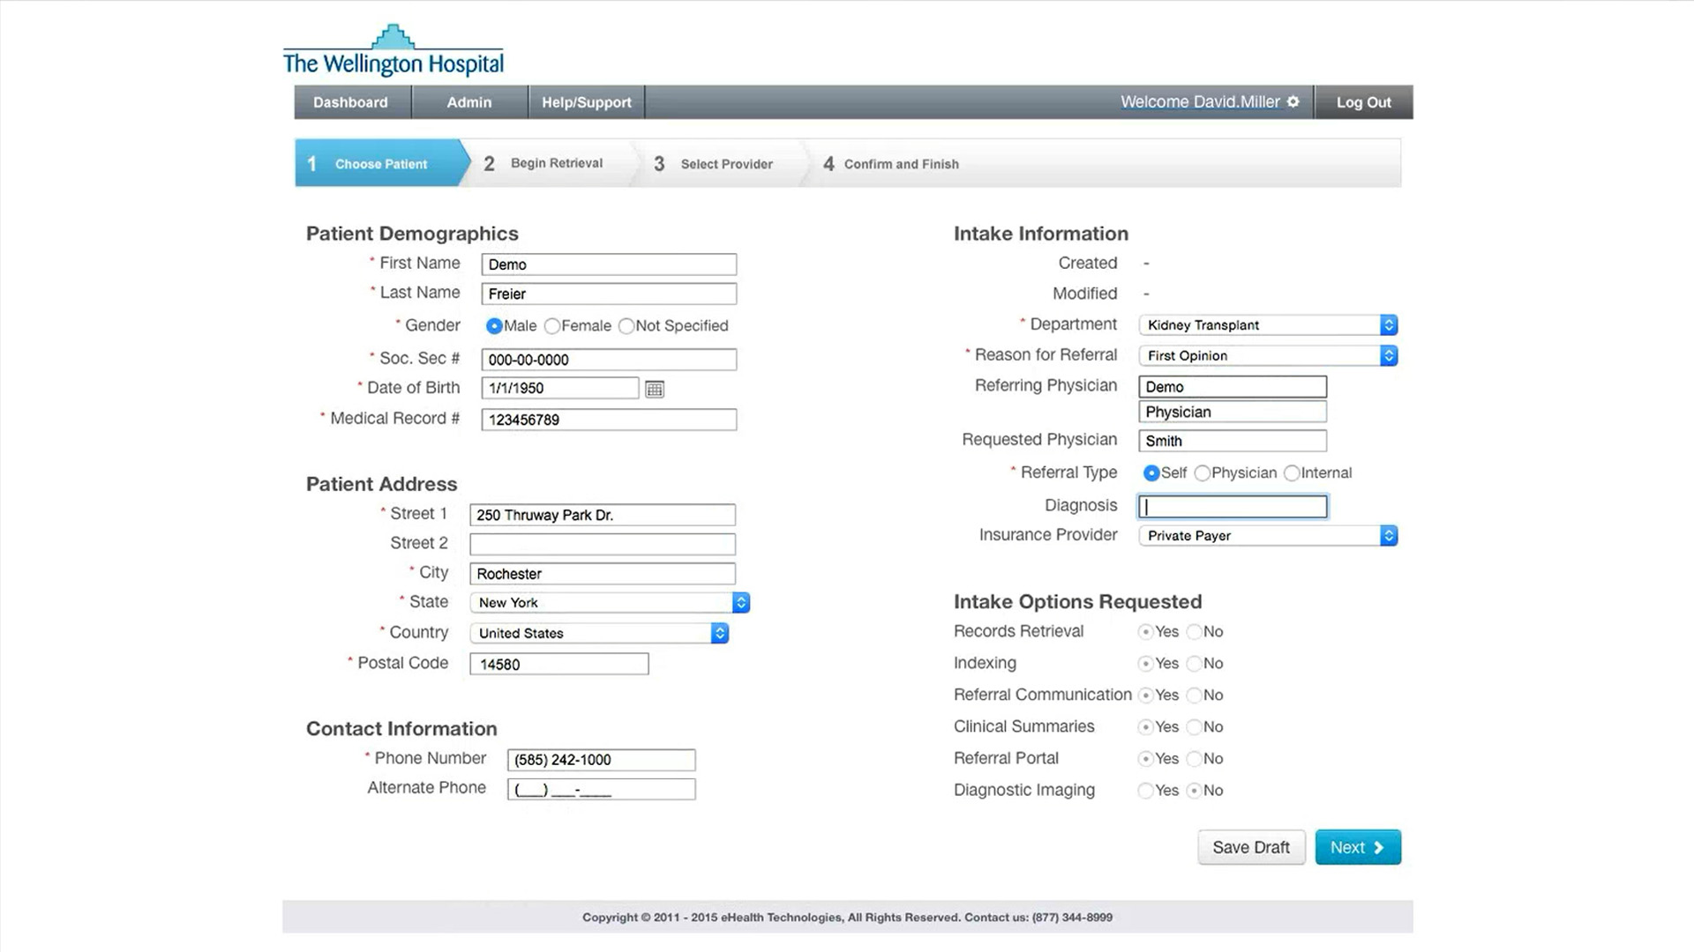
Enter an available diagnosis in the Diagnosis field

Slide 103

Enter an available diagnosis in the Diagnosis field

Slide 104
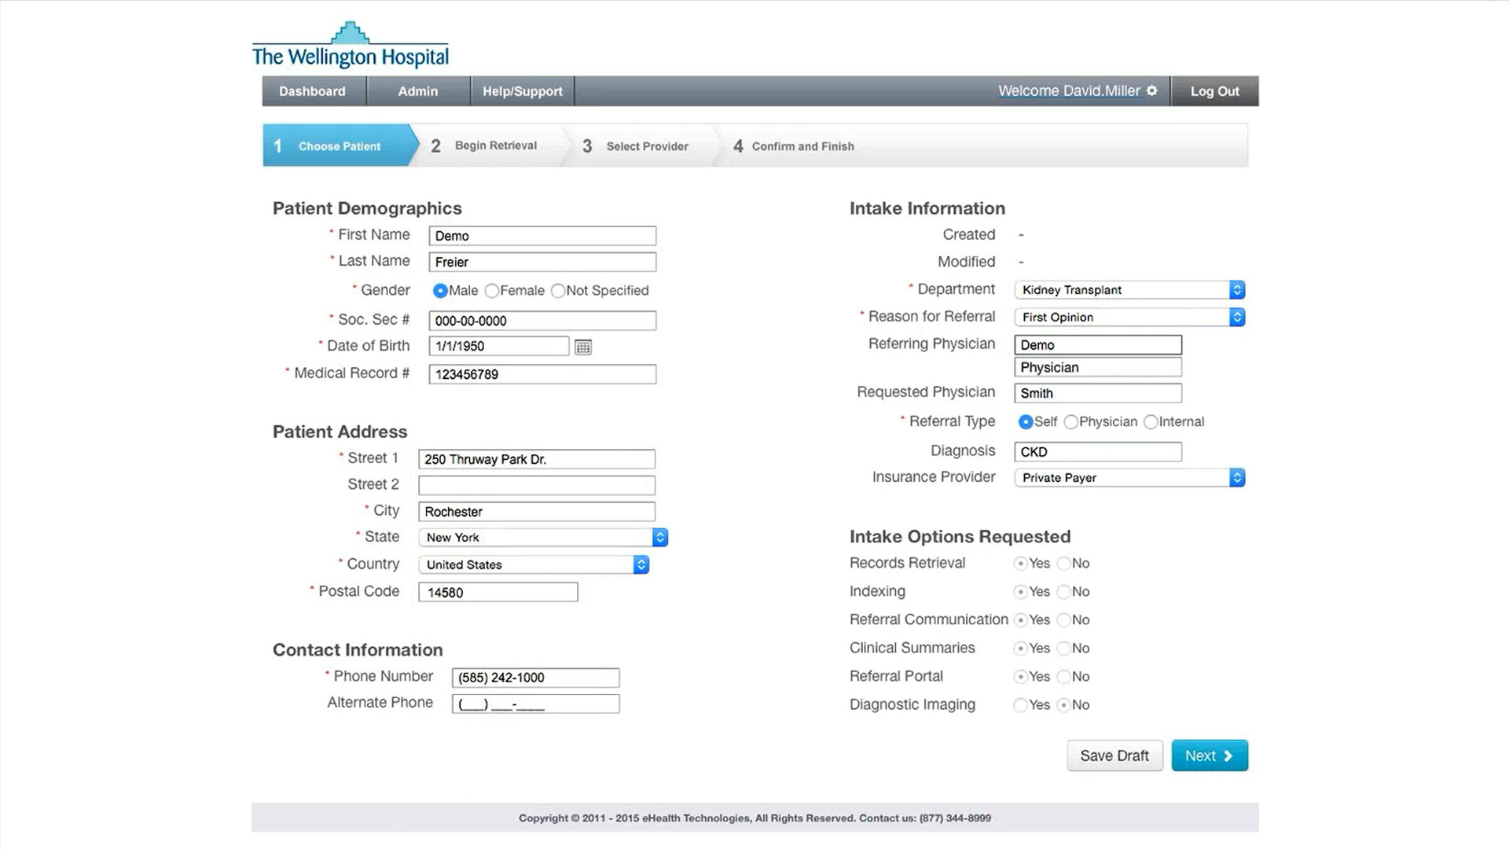
Indicate the Insurance Provider information from the selections available in the dropdown:

Slide 105
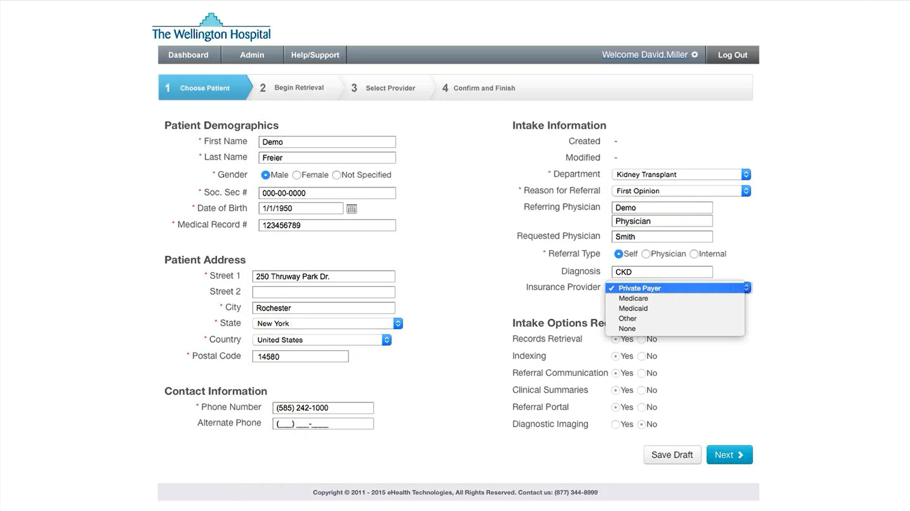
Indicate the Insurance Provider information from the selections available in the dropdown:
Private Payer

Slide 106

Indicate the Insurance Provider information from the selections available in the dropdown:
Private Payer
Medicare

Slide 107
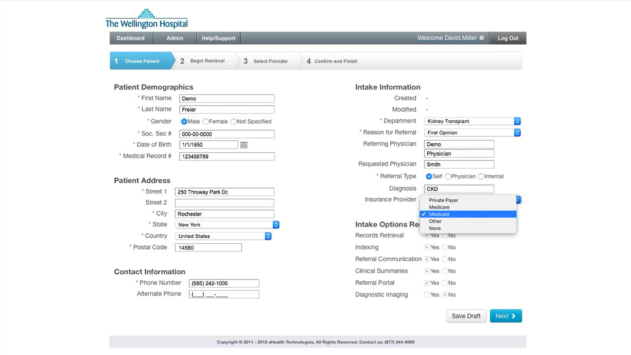
Indicate the Insurance Provider information from the selections available in the dropdown:
Private Payer
Medicare
Medicaid

Slide 108

Indicate the Insurance Provider information from the selections available in the dropdown:
Private Payer
Medicare
Medicaid
Other
NOTE: use the Other selection and free text field to enter provider information if a specific insurance provider is not included in the available selections

Slide 109

Indicate the Insurance Provider information from the selections available in the dropdown:
Private Payer
Medicare
Medicaid
Other
None

Slide 110
Indicate the Insurance Provider information from the selections available in the dropdown:
Private Payer
Medicare
Medicaid
Other
None

Slide 111
Indicate the Insurance Provider information from the selections available in the dropdown:
Private Payer
Medicare
Medicaid
Other
None

Slide 112
Once all information on this screen has been entered, you’ll need to specify when you need the records. Click the Next button to save and continue

Slide 113
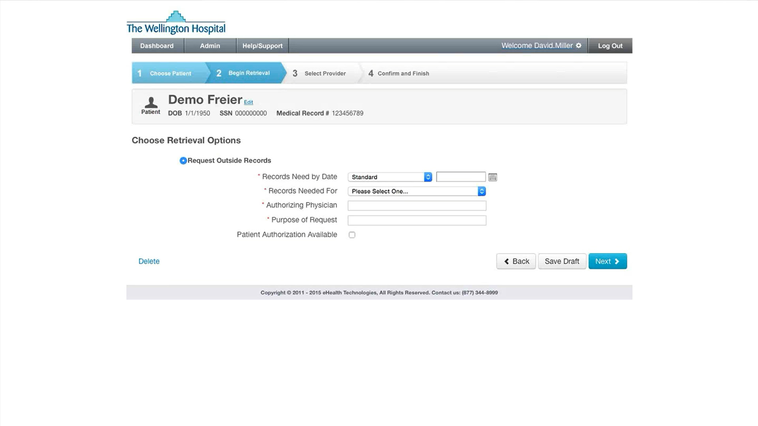
From the Choose Retrieval Options screen, you’ll enter information relating to the outside records request

Slide 114
From the Records Need by Date dropdown, choose from the options of:

Slide 115
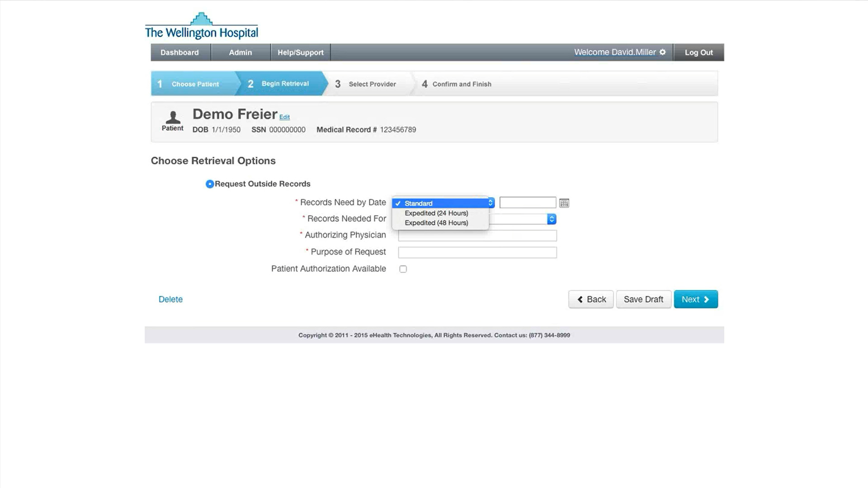
From the Records Need by Date dropdown, choose from the options of:
Standard - three day or more turnaround

Slide 116
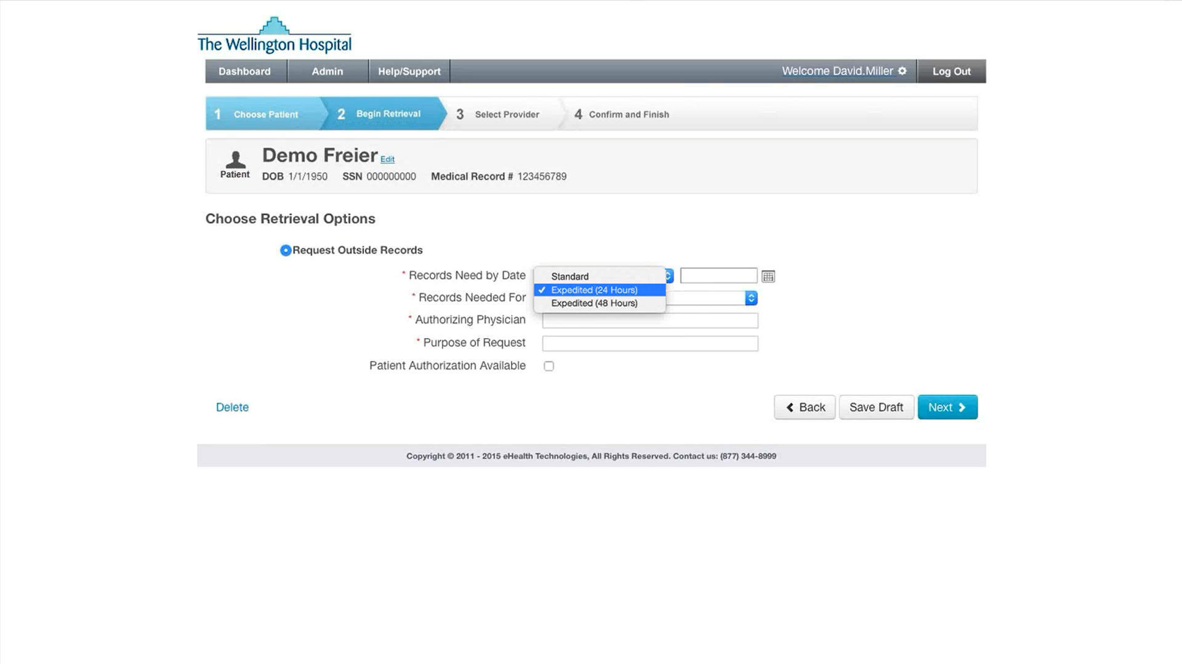
From the Records Need by Date dropdown, choose from the options of:
Standard - three day or more turnaround
Expedited (24 hours) -next day turnaround

Slide 117
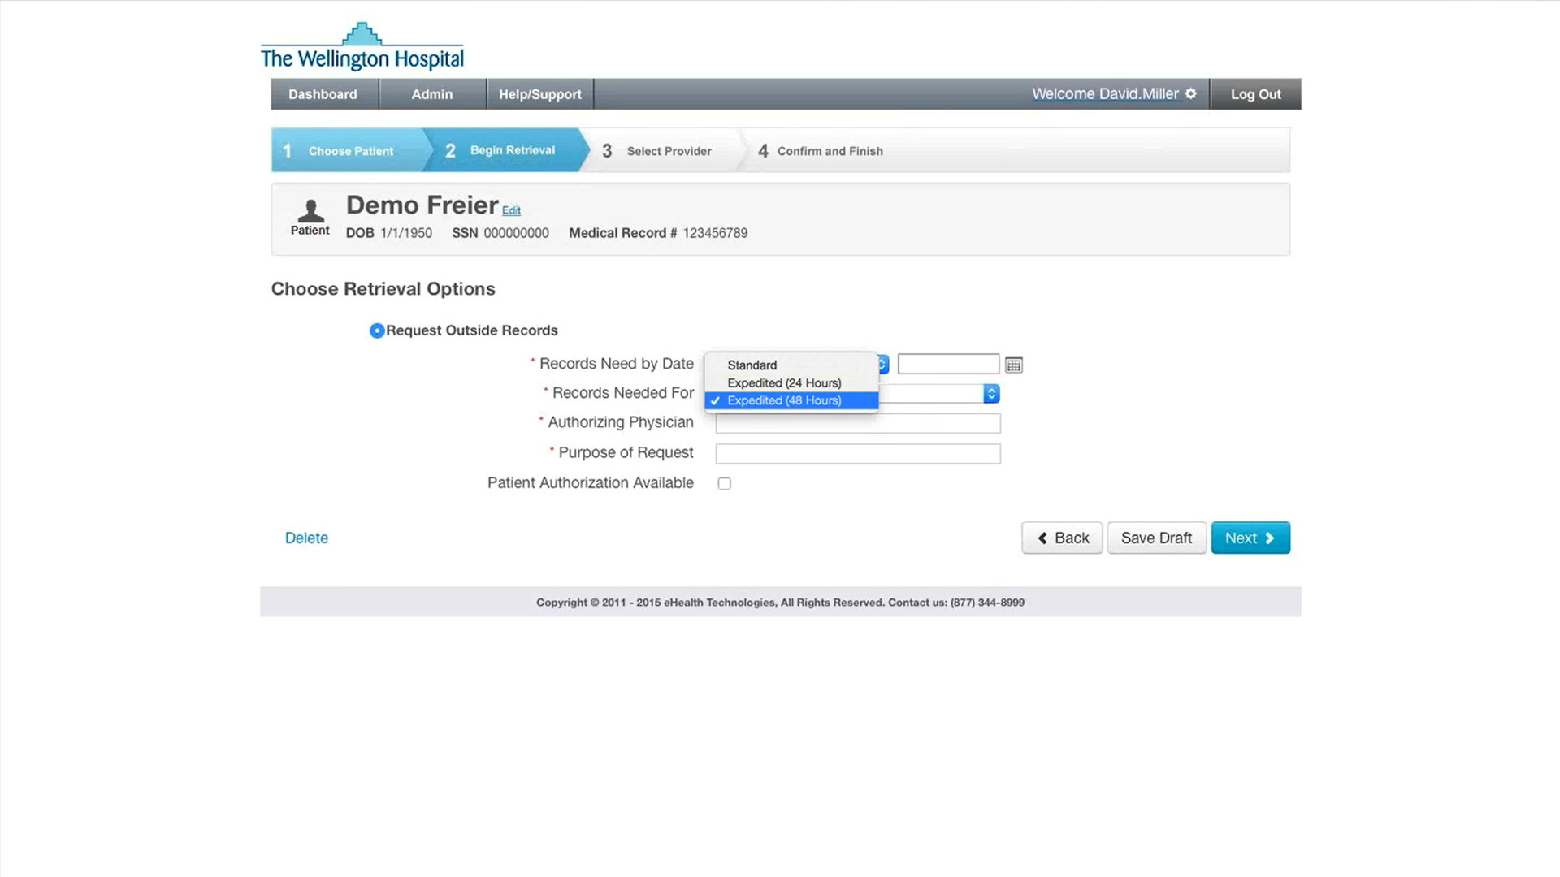
From the Records Need by Date dropdown, choose from the options of:
Standard - three day or more turnaround
Expedited (24 hours) -next day turnaround
Expedited (48 hours) - for 2-day turnaround

Slide 118
From the Records Need by Date dropdown, choose from the options of:
Standard - three day or more turnaround
Expedited (24 hours) -next day turnaround
Expedited (48 hours) - for 2-day turnaround
NOTE: eHealth Technologies will deliver the records as soon as available, even if prior to the requested date. Any delays will be communicated to the requestor ASAP

Slide 120
Click the calendar icon to specify the patient appointment or review date

Slide 121
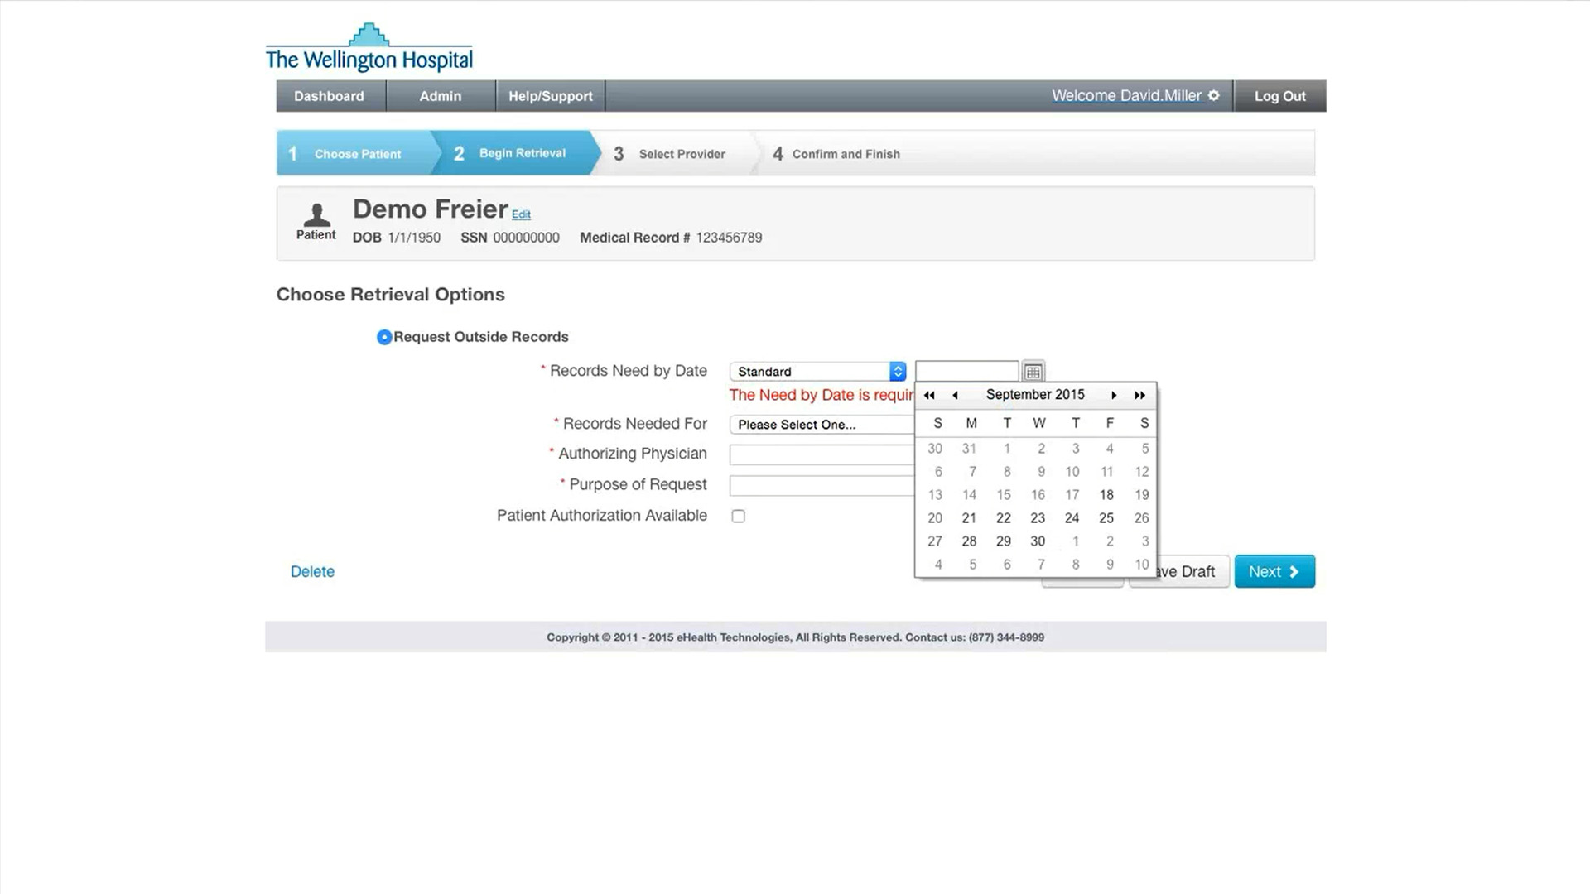
Click the calendar icon to specify the patient appointment or review date

Slide 122

Click the calendar icon to specify the patient appointment or review date

Slide 123

Click the calendar icon to specify the patient appointment or review date

Slide 124
Next, from the Records Needed For dropdown select:

Slide 125
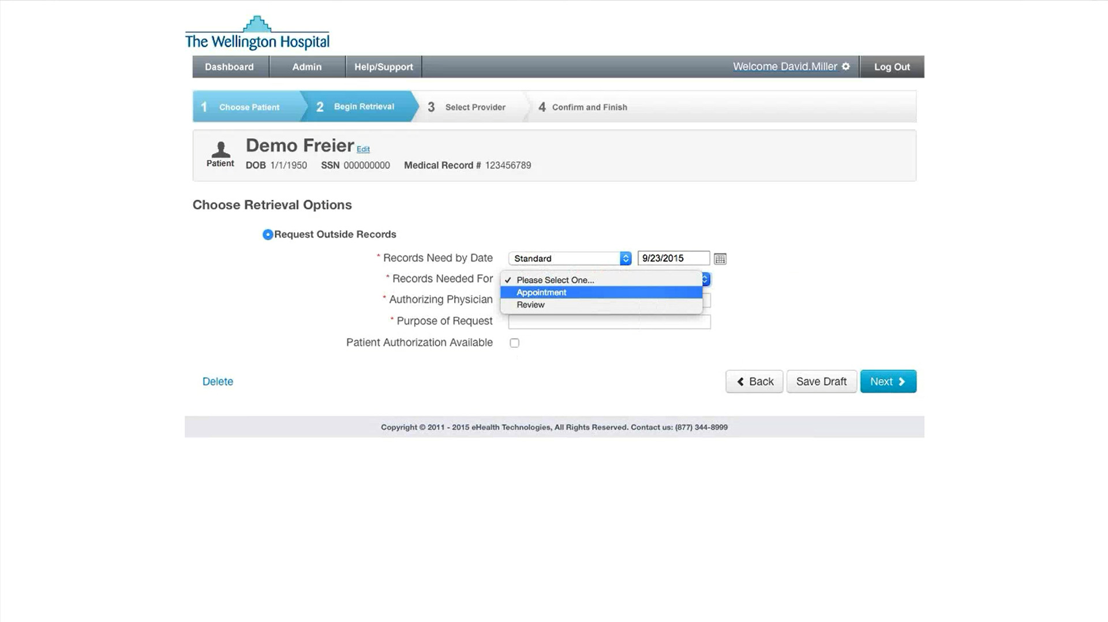
Next, from the Records Needed For dropdown select:
Appointment

Slide 126
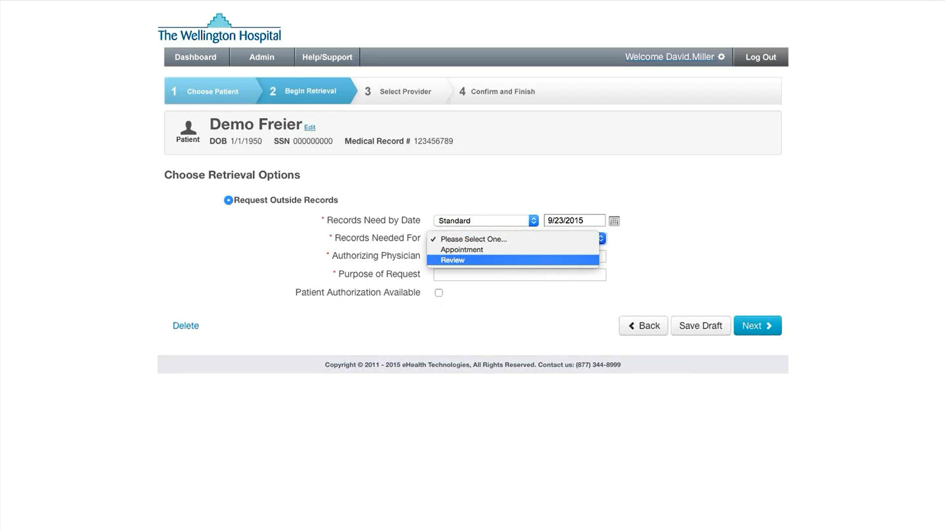
Next, from the Records Needed For dropdown select:
Appointment
Review

Slide 127
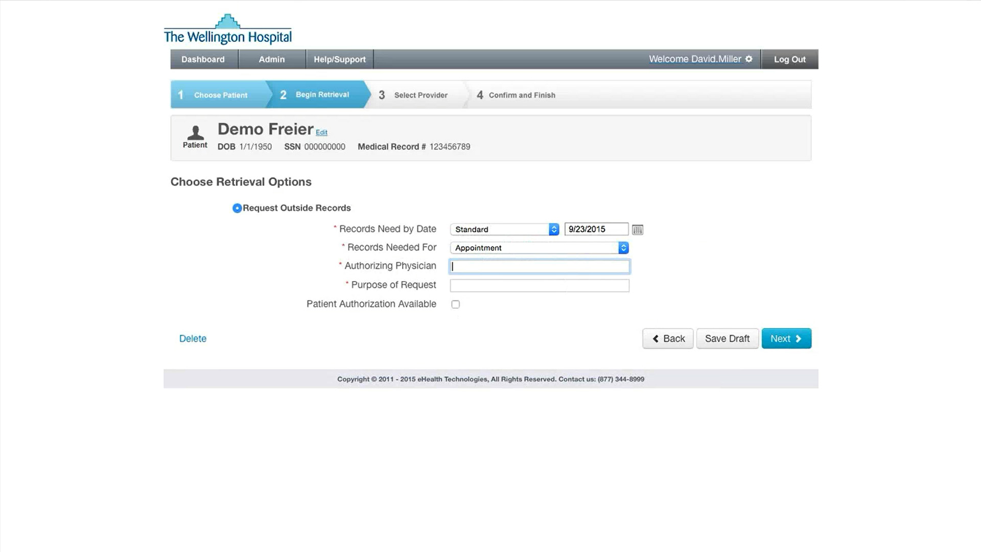
Next, from the Records Needed For dropdown select:
Appointment
Review

Slide 128
Now select the Authorizing Physician field to enter the name of physician the patient will be seeing at your facility

Slide 129

Now select the Authorizing Physician field to enter the name of physician the patient will be seeing at your facility

Slide 130
Now select the Authorizing Physician field to enter the name of physician the patient will be seeing at your facility
NOTE: if the patient is not scheduled with a specific physician at the time of referral, enter the name of a physician from the department where the patient will be seen

Slide 131

Use the Purpose of Request field to enter the reason a patient is being seen at your facility. Examples include:

Slide 132
Use the Purpose of Request field to enter the reason a patient is being seen at your facility. Examples include:
Consult

Slide 133
Use the Purpose of Request field to enter the reason a patient is being seen at your facility. Examples include:
Consult
Evaluation

Slide 134
Use the Purpose of Request field to enter the reason a patient is being seen at your facility. Examples include:
Consult
Evaluation
1st Opinion

Slide 135
Use the Purpose of Request field to enter the reason a patient is being seen at your facility. Examples include:
Consult
Evaluation
1st Opinion
2nd Opinion

Slide 136
Use the Purpose of Request field to enter the reason a patient is being seen at your facility. Examples include:
Consult
Evaluation
1st Opinion
2nd Opinion
Treatment

Slide 137
Use the Purpose of Request field to enter the reason a patient is being seen at your facility. Examples include:
Consult
Evaluation
1st Opinion
2nd Opinion
Treatment
Clinic Visit

Slide 138

Use the Purpose of Request field to enter the reason a patient is being seen at your facility. Examples include:
Consult
Evaluation
1st Opinion
2nd Opinion
Treatment
Clinic Visit

Slide 139
Use the Purpose of Request field to enter the reason a patient is being seen at your facility. Examples include:
Consult
Evaluation
1st Opinion
2nd Opinion
Treatment
Clinic Visit

Slide 140

The final action on this page is the Patient Authorization Available checkbox
Clicking this box will allow you to select and upload a scanned patient consent form directly to eHealth Technologies to use when requesting records, if needed

Slide 141
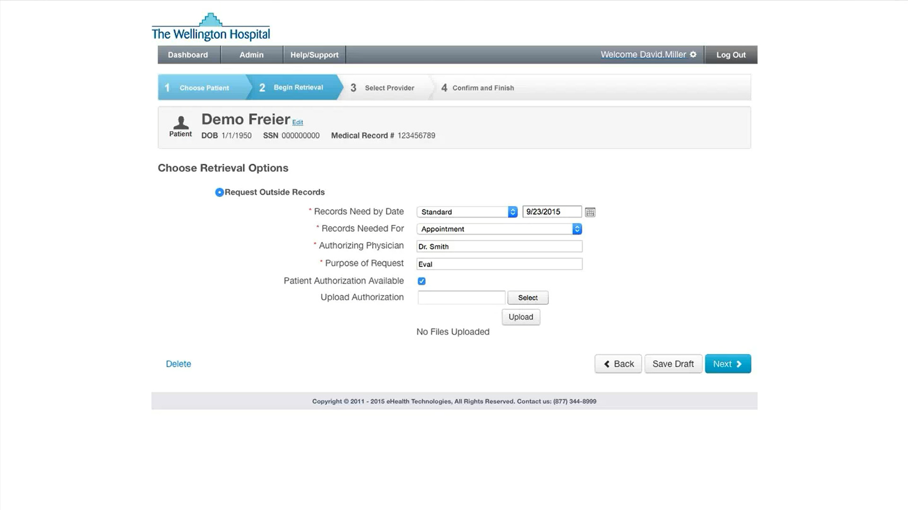
Clicking this box will allow you to select and upload a scanned patient consent form directly to eHealth Technologies to use when requesting records, if needed

Slide 142
Clicking this box will allow you to select and upload a scanned patient consent form directly to eHealth Technologies to use when requesting records, if needed

Slide 143
Clicking this box will allow you to select and upload a scanned patient consent form directly to eHealth Technologies to use when requesting records, if needed

Slide 144
Once the information on this page has been provided, click the Next button to save and continue

Slide 146
Now go on to the next program module:
(or go back to review a previous module)
INTRODUCTION
PATIENT DEMOGRAPHICS
PATIENT INTAKE OPTIONS
IDENTIFYING RECORDS PROVIDERS
MANAGE PATIENT TO-DO LIST

Slide 148
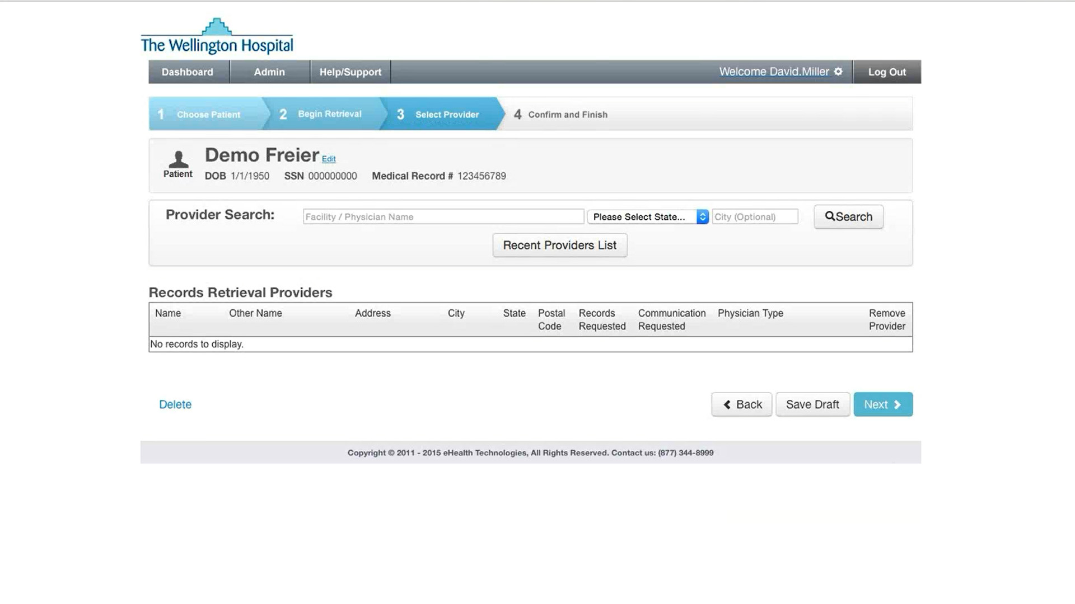
At this point in the process you have input the Patient Demographics, specified the Patient Intake Information, and provided Scheduling Information for when the records are needed

Slide 149
Now we will detail how to Identify Records Retrieval Providers and complete the Record Retrieval Request

Slide 150
There are two ways Records Retrieval Providers are identified:

Slide 151
There are two ways Records Retrieval Providers are identified:
By searching recent providers contained in your facility’s history

Slide 152
There are two ways Records Retrieval Providers are identified:
By searching recent providers contained in your facility’s history
By searching the National Provider Identifier (NPI) database

Slide 153
Click on the Recent Providers List button to view the last 150 providers that have supplied external records to your department

Slide 154
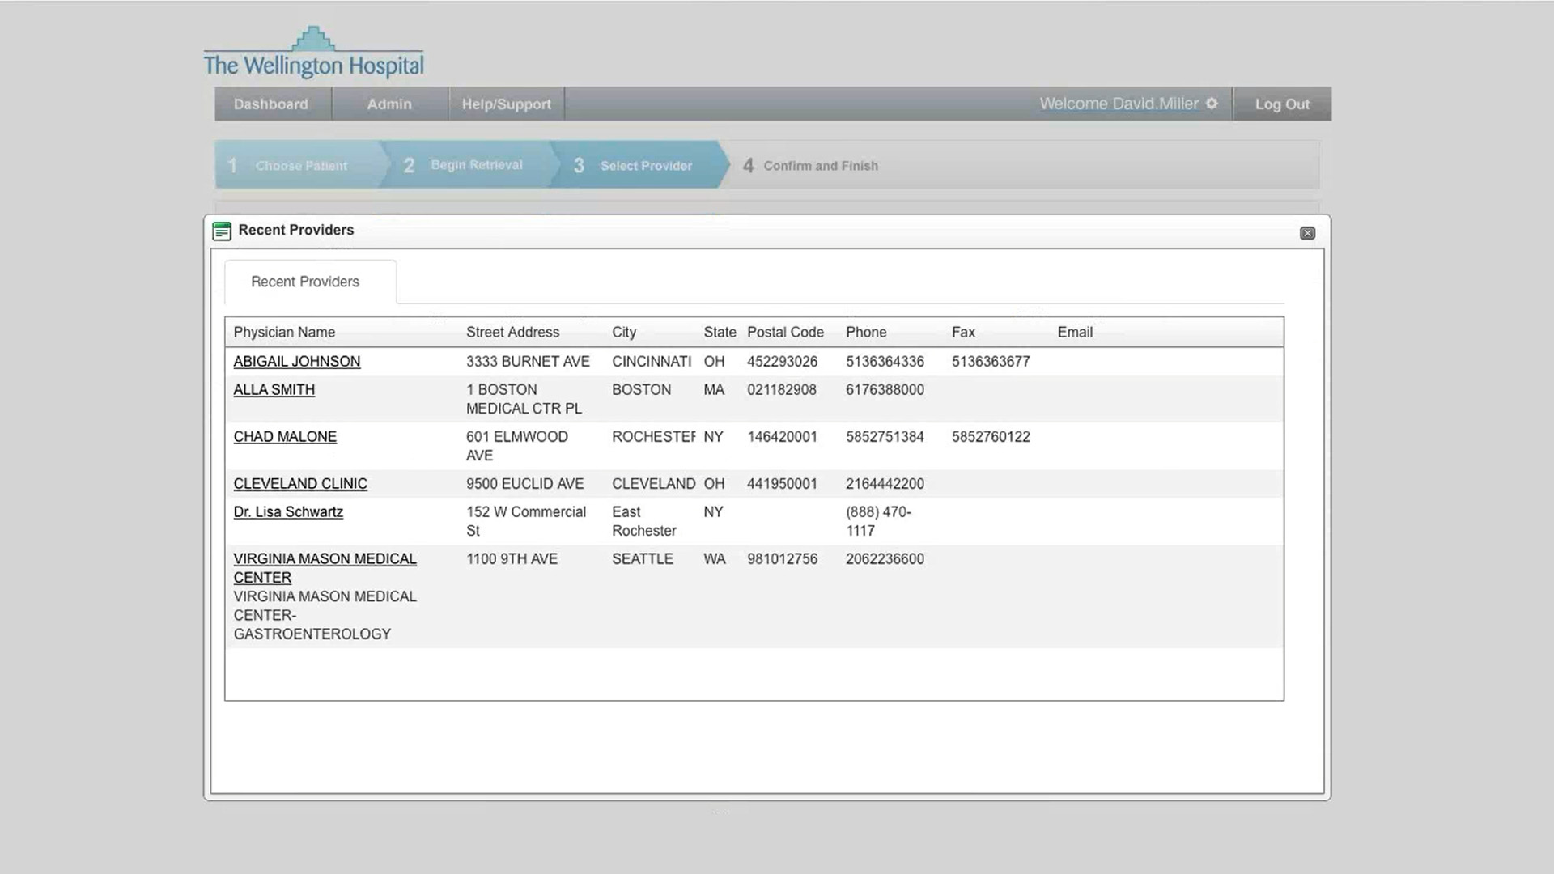
Select any displayed Physician Name to choose that provider as a record source

Slide 155
If the needed provider does not appear in the recent providers list, you’ll use the Provider Search function

Slide 156
If the needed provider does not appear in the recent providers list, you’ll use the Provider Search function. Click the “X” button to close the window and continue

Slide 157
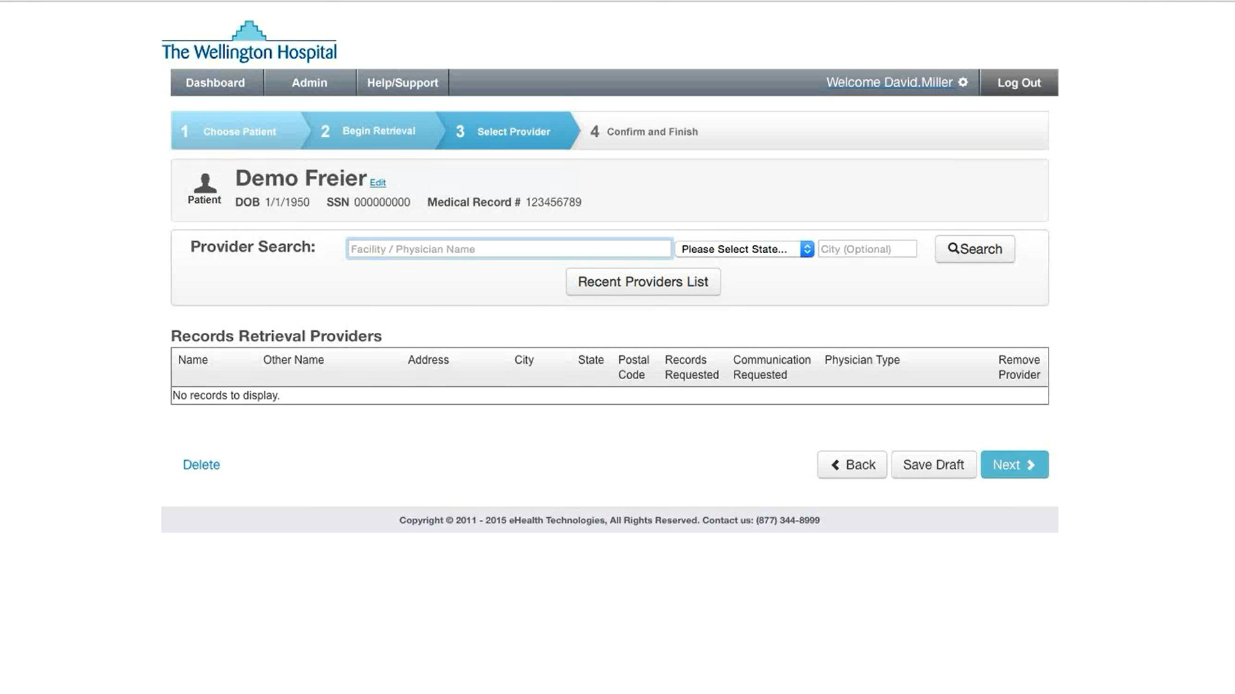
To use the Provider Search function you must:

Slide 158
To use the Provider Search function you must:
Enter a facility in the free text field

Slide 159

To use the Provider Search function you must:
Enter a facility in the free text field

Slide 160
To use the Provider Search function you must:
Enter a facility in the free text field
Select a State from the dropdown list

Slide 161
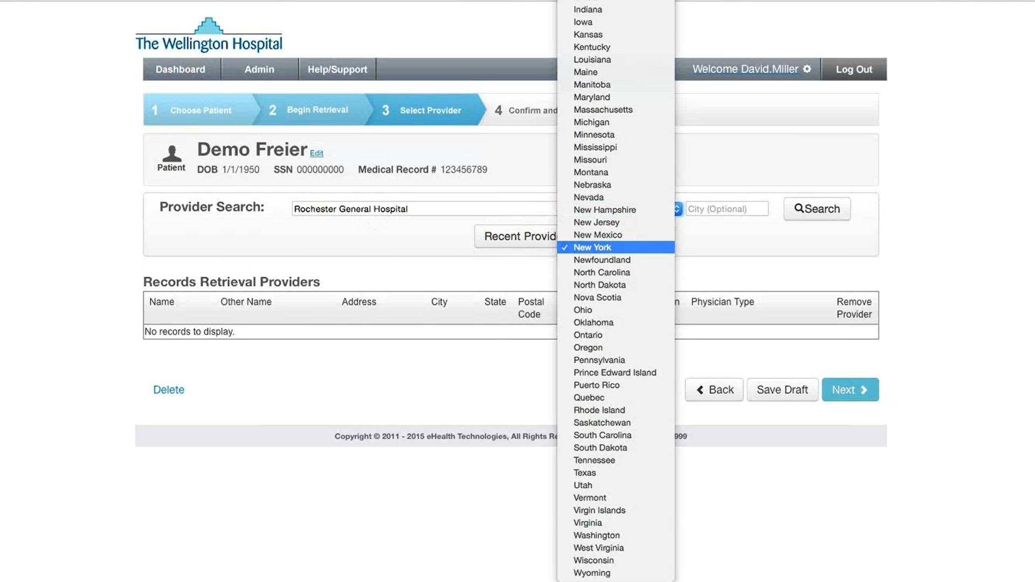
To use the Provider Search function you must:
Enter a facility in the free text field
Select a State from the dropdown list

Slide 162

To use the Provider Search function you must:
Enter a facility in the free text field
Select a State from the dropdown list

Slide 163
The City field is optional and usually necessary only when searching for providers with common surnames

Slide 164
Now click the Search button to execute the search and view the results

Slide 165
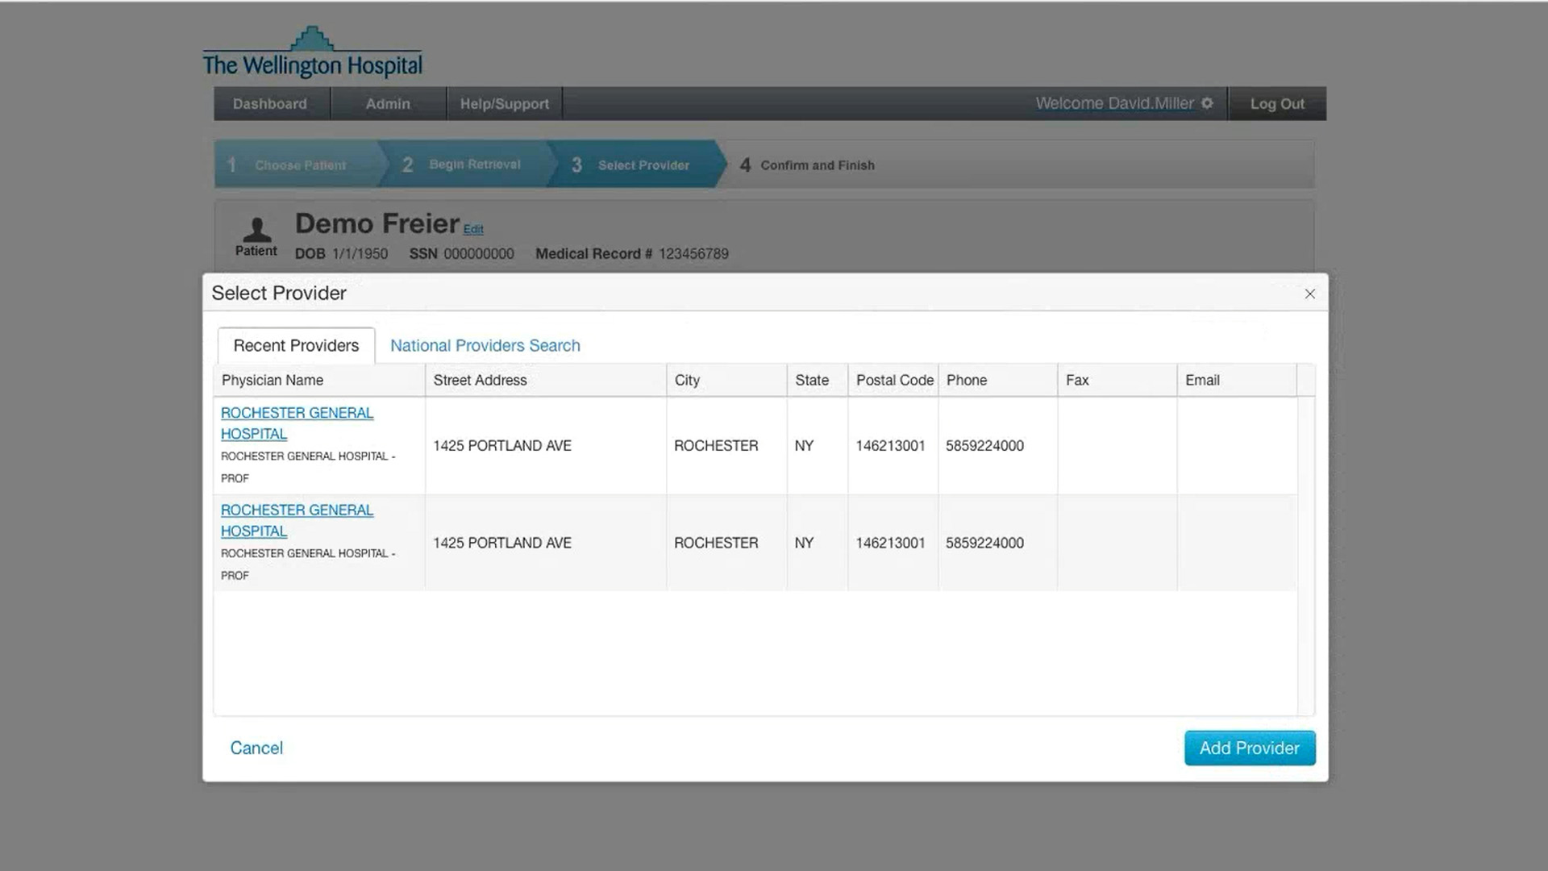
NOTE: the Select Provider window has 2 display tabs:

Slide 166
NOTE: the Select Provider window has 2 display tabs:
Recent Providers (default)

Slide 167
NOTE: the Select Provider window has 2 display tabs:
Recent Providers (default)
National Providers Search

Slide 168
If this list does not contain the needed provider, or the search results are blank, click on the National Providers Search tab to execute the NPI database search

Slide 169
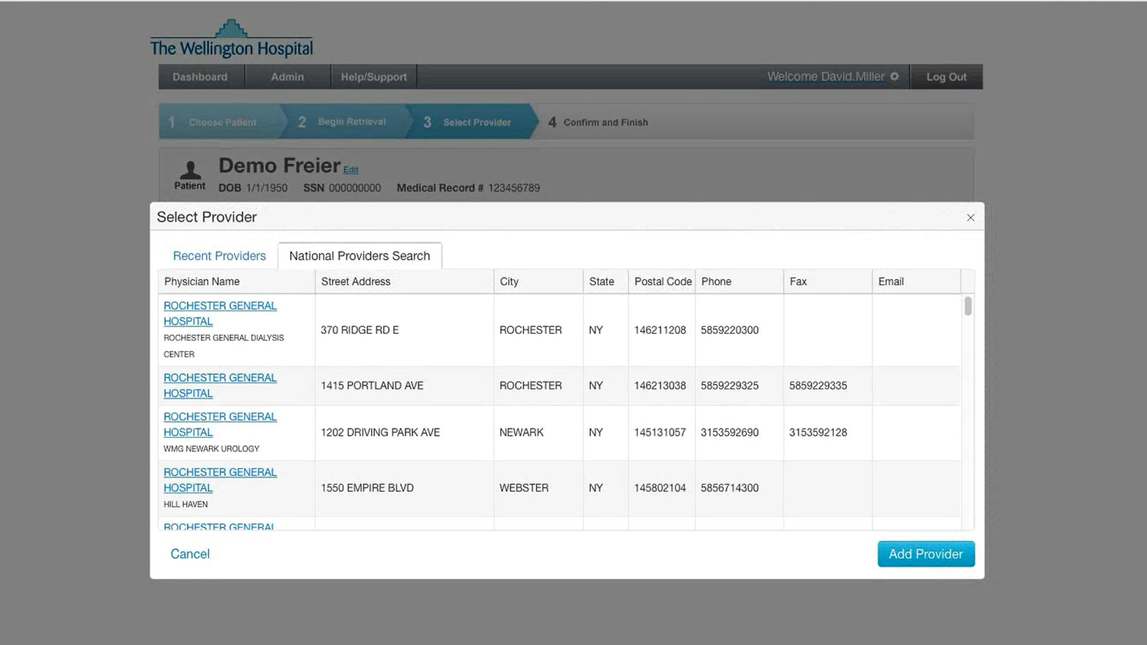
Select the provider you are looking for to include them as a records retrieval provider and continue

Slide 170
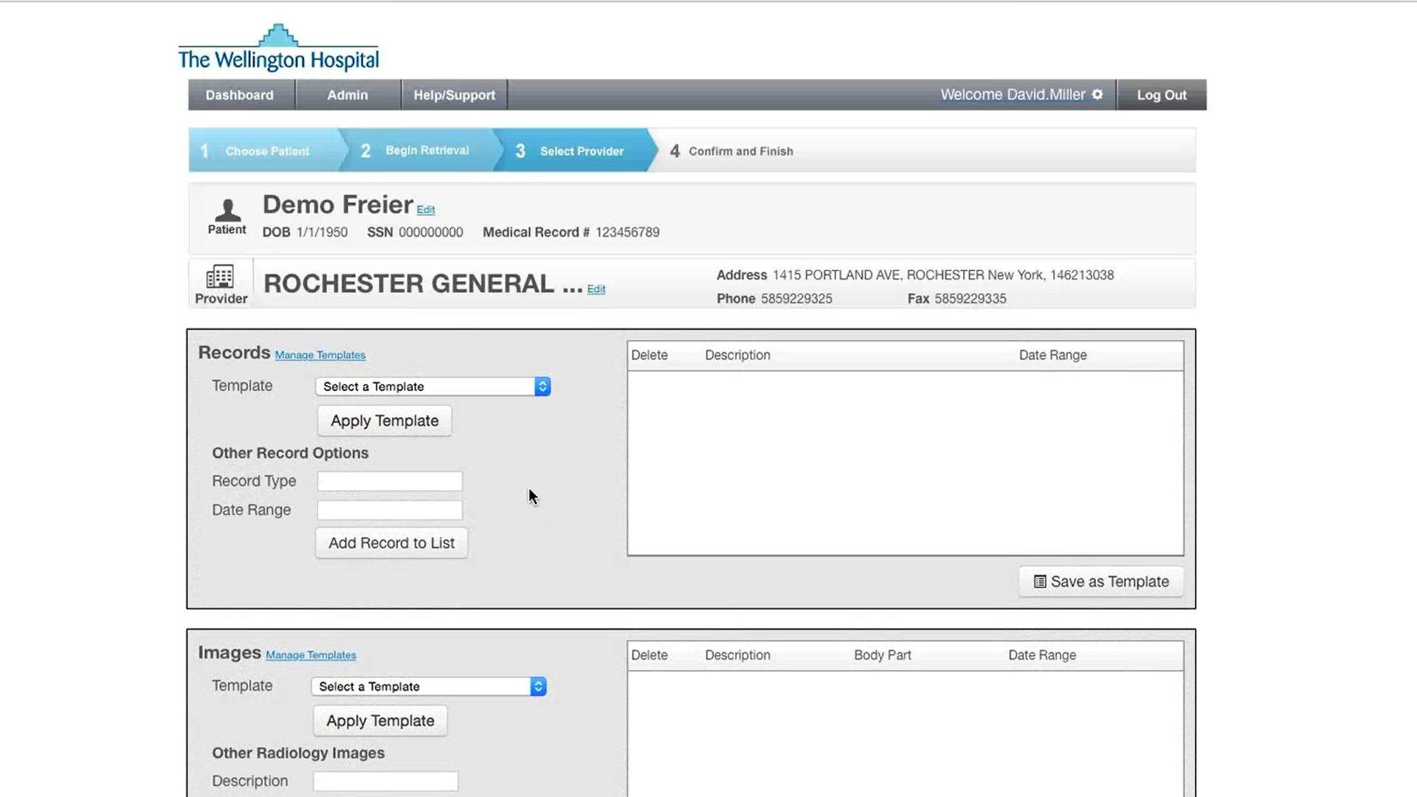
Our next tasks are to define which Records, Images, and Pathology are to be requested

Slide 171
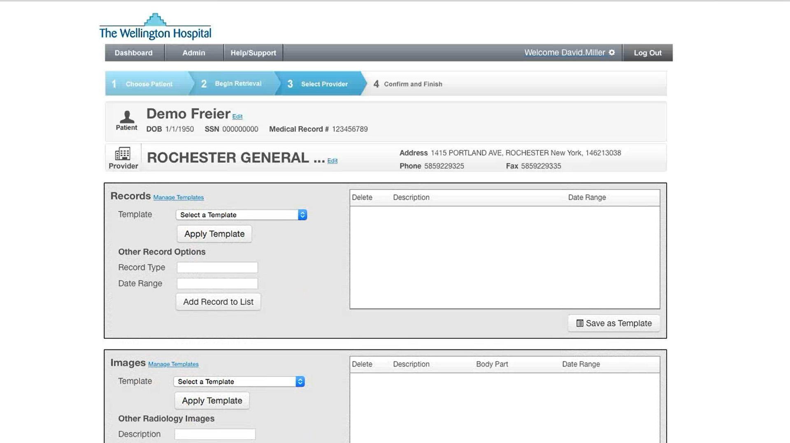
The Records area allows us to specify the various reports you need

Slide 172

Use the Images area to have patient images shipped to your facility on disc, or delivered electronically to your Picture Archiving and Communication System (PACS) if supported by your facility

Slide 173

The Pathology area will be used if you need actual biopsy slides delivered to your facility

Slide 174

Each area has two process options:

Slide 175
Each area has two process options:
Template

Slide 176
Each area has two process options:
Template
Other Record Options

Slide 177
If you only need a few items from any of the Reports, Images, and Pathology areas, select available options from the Record Type Quick List dropdown

Slide 178

If you only need a few items from any of the Reports, Images, and Pathology areas, select available options from the Record Type Quick List dropdown

Slide 179
This field is also a free text field so you can specify a report that isn’t already included in the Quick List

Slide 181
For example, from the Records area Other Record Options, click in the Record Type and select an option

Slide 182
For example, from the Records area Other Record Options, click in the Record Type and select an option

Slide 183

For example, from the Records area Other Record Options, click in the Record Type and select an option

Slide 184

Then select Date Range to indicate when the records were created

Slide 185

Then select Date Range to indicate when the records were created

Slide 186

Then select Date Range to indicate when the records were created
NOTE: if the date range is not specified, the range will default to “Most Recent”

Slide 187

Once those items are selected, click the Add Record to List button to update the records list. Repeat if additional records are required

Slide 188

Once those items are selected, click the Add Record to List button to update the records list. Repeat if additional records are required

Slide 189

Once those items are selected, click the Add Record to List button to update the records list. Repeat if additional records are required

Slide 190

Once those items are selected, click the Add Record to List button to update the records list. Repeat if additional records are required

Slide 191

Once those items are selected, click the Add Record to List button to update the records list. Repeat if additional records are required

Slide 192

Once those items are selected, click the Add Record to List button to update the records list. Repeat if additional records are required

Slide 193

Once those items are selected, click the Add Record to List button to update the records list. Repeat if additional records are required

Slide 194

Once those items are selected, click the Add Record to List button to update the records list. Repeat if additional records are required

Slide 195

Once those items are selected, click the Add Record to List button to update the records list. Repeat if additional records are required

Slide 196

Report Lists created using the Other Records Options can be saved as a Template by clicking the Save as Template button for reuse later
NOTE: This function is only available to designated managers at your facility

Slide 197
When you know multiple records are needed, you’ll often use the Template method to request your facility’s standard groups of Reports, Images, and Pathology. Templates group several record requests by procedure for a newly referred patient

Slide 198
Select a Template from the dropdown list

Slide 199

Select a Template from the dropdown list

Slide 200

Click the Apply Template button

Slide 201

NOTE: if you already have added reports to the list, RMS will ask you to merge with, or replace, those reports already specified. Click on the appropriate choice button to apply the template

Slide 202
NOTE: if you already have added reports to the list, RMS will ask you to merge with, or replace, those reports already specified. Click on the appropriate choice button to apply the template

Slide 203

The same process applies to requesting records from the Images area

Slide 204
You can either select and apply a Template

Slide 205

You can either select and apply a Template

Slide 206

You can either select and apply a Template

Slide 207

You can either select and apply a Template
or choose (or specify) Other Radiology Images by Description, Body Part, and Date Range

Slide 208
You can either select and apply a Template
or choose (or specify) Other Radiology Images by Description, Body Part, and Date Range

Slide 209

You can either select and apply a Template
or choose (or specify) Other Radiology Images by Description, Body Part, and Date Range
Left Heart Cath

Slide 210

You can either select and apply a Template
or choose (or specify) Other Radiology Images by Description, Body Part, and Date Range

Slide 211

You can either select and apply a Template
or choose (or specify) Other Radiology Images by Description, Body Part, and Date Range

Slide 212

You can either select and apply a Template
or choose (or specify) Other Radiology Images by Description, Body Part, and Date Range

Slide 213

You can either select and apply a Template
or choose (or specify) Other Radiology Images by Description, Body Part, and Date Range

Slide 214

You can either select and apply a Template
or choose (or specify) Other Radiology Images by Description, Body Part, and Date Range

Slide 215
You can either select and apply a Template
or choose (or specify) Other Radiology Images by Description, Body Part, and Date Range

Slide 216

You can either select and apply a Template
or choose (or specify) Other Radiology Images by Description, Body Part, and Date Range

Slide 217

You can either select and apply a Template
or choose (or specify) Other Radiology Images by Description, Body Part, and Date Range

Slide 218

You can either select and apply a Template
or choose (or specify) Other Radiology Images by Description, Body Part, and Date Range

Slide 219
Click Add Radiology Image to List

Slide 220


Slide 221

Again, the Template and Other Pathology Slide methods are available for your use in the Pathology area. Make your selections, or add individual pathology requests as required

Slide 222
Again, the Template and Other Pathology Slide methods are available for your use in the Pathology area. Make your selections, or add individual Pathology requests as required

Slide 223

The final section on this page is Explanation of Request. Do not use this area to make any Records, Images, or Pathology requests – these must be done above in the three gray boxed areas

Slide 224
Use Explanation of Request to provide information eHealth Technologies may need to obtain the requested records, or contact the patient

Slide 225
For example, if the patient speaks a language other than English, or if there is a proxy involved in records authorization (or patient care) that eHealth Technologies may need to know about

Slide 226
If you need to temporarily leave the record collection process for this patient, click the Save Draft button so you can return at a later time and finish the request

Slide 227
Once all areas are completed, click on the Next button to save and return you to the Records Retrieval Providers screen, now populated with the Provider information as well as the Records Requested

Slide 228

Once all areas are completed, click on the Next button to save and return you to the Records Retrieval Providers screen, now populated with the Provider information as well as the Records Requested

Slide 229
To add additional providers, repeat the process of provider search and records selection

Slide 230
To add additional providers, repeat the process of provider search and records selection

Slide 231

You will submit one request for all the providers you require Records, Images, or Pathology from - NOT one request for each provider

Slide 232

If requesting records from additional providers, you can use the Copy Selections From function to select the entire range of Records, Images, and Pathology from these additional providers

Slide 233
Select a provider from the dropdown list then click the Copy Selections button to duplicate the requests to this new provider

Slide 234

Select a provider from the dropdown list then click the Copy Selections button to duplicate the requests to this new provider

Slide 235

Select a provider from the dropdown list then click the Copy Selections button to duplicate the requests to this new provider

Slide 236

All the displayed copied information is editable. Make any revisions as necessary and click the
Next button to continue

Slide 237
All the displayed copied information is editable. Make any revisions as necessary and click the
Next button to continue

Slide 238

NOTE – for any patient records request, you have the option to enter up to seven providers with three locations per provider (each Records, Image, or Pathology request is considered one “Location”)

Slide 239
Once all records have been requested, click the Next button to continue and complete the request

Slide 240

At this point, a request preview is presented. You can review the request and revise any aspect of the Patient Demographics, Intake Information, or Records and Provider information, if needed, by clicking the Back button

Slide 241
NOTE: use the navigation arrows at the top of the screen to view hidden portions of the preview page

Slide 242
If everything appears as correct and no additional items are needed, click the Submit Request button to finalize the request and submit it to eHealth Technologies for action

Slide 243

Once submitted, you will receive a verification screen with a confirmation bar containing a green checkmark, and a Confirmation Number. This verification screen confirms eHealth Technologies has received the request and will begin work on collecting the requested records

Slide 244
NOTE: if you do not see the verification screen with the green checkmark and confirmation number, the record request did NOT go through. You may have to resubmit the request or contact eHealth Technologies to help you resolve any issues

Slide 245
Click the Done button to return to the main Dashboard page

Slide 246


Slide 247
Now go on to the next program module:
(or go back to review a previous module)
INTRODUCTION
PATIENT DEMOGRAPHICS
PATIENT INTAKE OPTIONS
IDENTIFYING RECORDS PROVIDERS
MANAGE PATIENT TO-DO LIST

Slide 249
At this point you have completed a Records Request by inputting the Patient Demographics, specifying the Patient Intake Information, providing Scheduling Information for when the records are needed, and identifying Records Providers

Slide 250
Once eHealth Technologies has sent you patient records or messages, those patients will appear in the Patient List when applying the To Do filter

Slide 251

Click on the patient name to navigate to the Patient Page

Slide 252

At the top of the Patient Page, you’ll see the gray Patient Demographics area. If needed, click Edit to make changes to this information

Slide 253

Update any information and click the Update Patient button the complete the update process and return to the Patient Page

Slide 254
Click on the Records Retrieval tab to view information on records status

Slide 255

Please take note of the Communication Thread that runs down the left side of the page. Use this function to communicate directly with eHealth Technologies without needing to use eMail. The most recent message will be displayed at the top of the message column

Slide 256
NOTE: any messages that you have not replied to will be marked in red as “New!” Also, this is NOT instant messaging. eHealth Technologies will respond to these messages within one hour but not immediately

Slide 257
If you have Requests in process where records are being retrieved, those Requests will be listed under the Active tab

Slide 258
By clicking the All tab, you will be able to view:

Slide 259

By clicking the All tab, you will be able to view:
Request “R” Number

Slide 260
By clicking the All tab, you will be able to view:
Request “R” Number
The eHealth Technologies Case #

Slide 261
By clicking the All tab, you will be able to view:
Request “R” Number
The eHealth Technologies Case #
Record Type

Slide 262
By clicking the All tab, you will be able to view:
Request “R” Number
The eHealth Technologies Case #
Record Type
Provider Information

Slide 263
By clicking the All tab, you will be able to view:
Request “R” Number
The eHealth Technologies Case #
Record Type
Provider Information
Record Status

Slide 264
By clicking the All tab, you will be able to view:
Request “R” Number
The eHealth Technologies Case #
Record Type
Provider Information
Record Status
Actions

Slide 265
There are three possible Status types:

Slide 266
There are three possible Status types:
Complete (request has been fulfilled)

Slide 267
There are three possible Status types:
Complete (request has been fulfilled)
In Process (request is being actively worked on)

Slide 268
There are three possible Status types:
Complete (request has been fulfilled)
In Process (request is being actively worked on)
No Records Available (an item is not available)

Slide 269
You can click on a status to view details regarding the request

Slide 270

These consist of eHealth Technologies internal case notes

Slide 271
Telephone and fax numbers will always be the first items on the status detail, followed by the date and time stamps of the eHealth Technologies Specialists who are doing the actual records follow up on your request

Slide 272
Each location is contacted daily until Records, Images, or Pathology have been received

Slide 273
NOTE: if a status is No Records Available, eHealth Technologies will notify you as to why the record was unavailable; for example, slides have been destroyed, images have been purged, or an exam has not been completed by the Requested By date

Slide 274
In the Actions column you will be able to view three types of information:

Slide 275
In the Actions column you will be able to view three types of information:
12-digit FedEx Tracking Numbers

Slide 276
In the Actions column you will be able to view three types of information:
12-digit FedEx Tracking Numbers
Download (click to download hosted files)

Slide 277
In the Actions column you will be able to view three types of information:
12-digit FedEx Tracking Numbers
Download (click to download hosted files)
View File List (shows files already downloaded)

Slide 278
Click the View Intake button to view a copy of the confirmation report generated when you submit a request

Slide 279


Slide 280
Click the “X” button to close the report window

Slide 281
Clicking the Activity Log button will display a detailed audit trail of all users who have accessed a package, downloaded records, or altered patient information

Slide 282

Clicking the Activity Log button will display a detailed audit trail of all users who have accessed a package, downloaded records, or altered patient information

Slide 283
Click the “X” button to close the report window

Slide 284
Click the Retrieve Additional Records button to submit a new request using the patient demographics entered in the initial request

Slide 285

At the bottom of the page you will see the Patient Notes box. Use this area to keep your own personal notes. This information is not shared or transmitted to eHealth Technologies

Slide 286
The Patient Files upload tool located at the lower left hand corner of the page allows you to upload and forward electronic patient files to eHealth Technologies. This is a very handy alternative to printing and faxing paper files

Slide 287

Scroll to the top of the page and click the Dashboard button to return to the home Dashboard screen

Slide 290
This concludes the RMS Orientation Program
If you have questions, or require any additional information, please contact our technical support staff at:
877-344-8999 - Option 5
The support line is open Monday - Friday from 8:30am to 7:30pm Eastern time

Slide 292
You can also email our support staff at:
support@ehealthtechnologies.com
As stated previously, please be aware that email sent to the support email address is unencrypted and not suitable for communicating any confidential PHI identifiers

Slide 294
Intelligent Health Record Aggregation Platform Referral Management Solution (RMS)
Thank you for your attention and for choosing eHealth Connect® Intelligent Health Record Aggregation
Your Online Solution to Patient Record Requests, Retrieval, and Intelligent Organization

Slide 296
Click the STOP Sign to exit the program:
(or go back to review a previous module)
INTRODUCTION
PATIENT DEMOGRAPHICS
PATIENT INTAKE OPTIONS
IDENTIFYING RECORDS PROVIDERS
MANAGE PATIENT TO-DO LIST

